Slide 1
Why does Intellectual Property (IP) matter to your business?
24 April 2025
Presented by | Dr Melvyn Ansell, Patent Attorney

Slide 2
Topics for today
***SPOILER ALERT***
Topics for today
Why IP matters to your business? (WHY)
Protecting your IP (WHAT)
Developing an IP strategy (WHEN, WHERE and HOW)
IP infringement
Putting it altogether
secerna.com

Slide 3
About me
Dr Melvyn Ansell
(mansell@secerna.com)
Patent Attorney
secerna.com

Slide 4
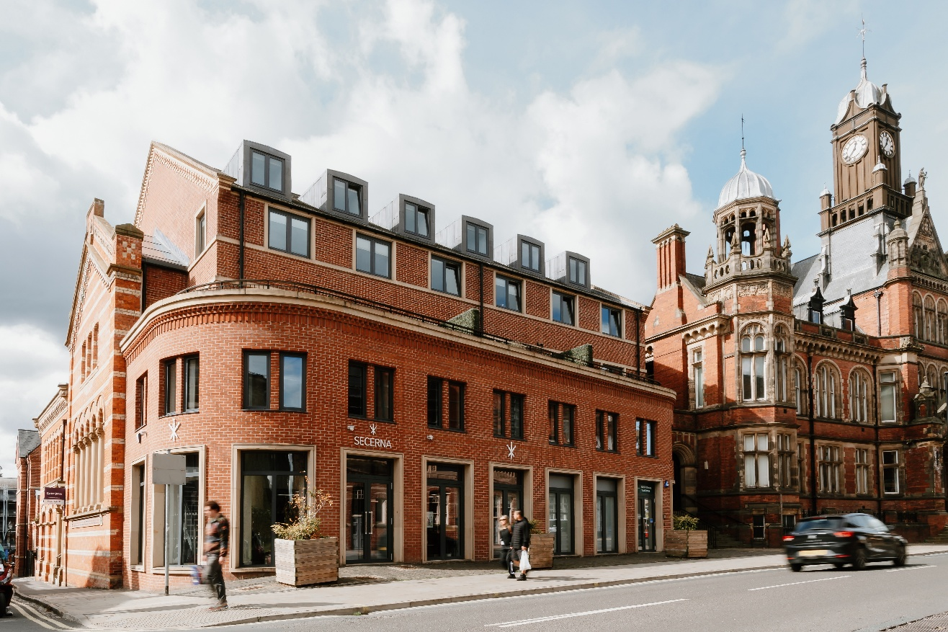
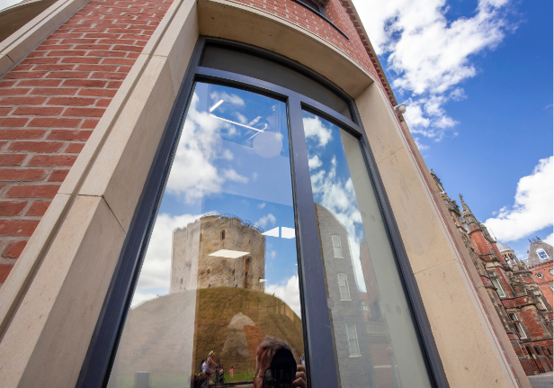
About Secerna LLP
secerna.com

Slide 5
Why IP matters to your business? (WHY)

Slide 6
Intellectual Property (IP)
Trade marks
Domain names
Designs
INTELLECTUAL PROPERTY
Copyright
Patents
Trade secrets
secerna.com

Slide 7
Common barriers to IP
Why Intellectual Property (IP) matters to your business?
IP plays a vital role in protecting your innovation
Your business owns IP
Common barriers to IP
High cost
Complexity
Time-consuming
Result
Deprioritize IP protection, or
Avoided altogether
secerna.com

Slide 8
Risks of not protecting your IP
RISKS
Loss of competitive edge
Financial loss
Damage to reputation
Difficulty attracting investors
Cyber security threats
Operational disruption
secerna.com

Slide 9
Benefits of early IP strategy
BENEFITS
Competitive advantage
Attracting investors
Legal protection
Business growth and expansion
Brand reputation
Long-term planning
secerna.com

Slide 10
Protecting your IP rights (WHAT)

Slide 11
Patents
What are patents
Protect inventions
Invention must be novel, inventive and industrially applicable.
Exclusive “negative” right
Typical lifetime is about 20 years
Disclosure requirement
Territorial
secerna.com

Slide 12
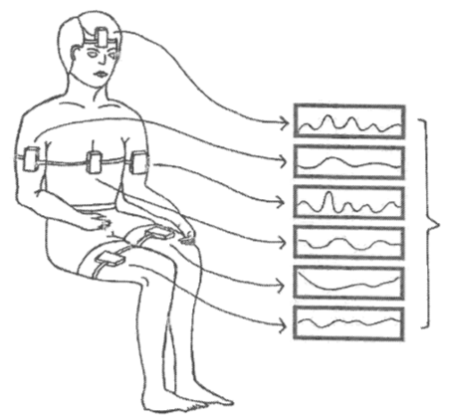
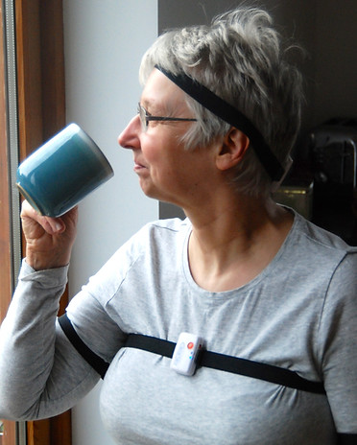
Patents
Source: ClearSky MD
Figure 1 of EP2872041
secerna.com

Slide 13
Trade marks
What are trade marks
Sign used to distinguish trade origin
Can be words, sounds, logos, colours, shapes, or a combination of these
Must be distinctive
Can last indefinitely
Prevent others from using similar marks that could confuse consumers
secerna.com

Slide 14
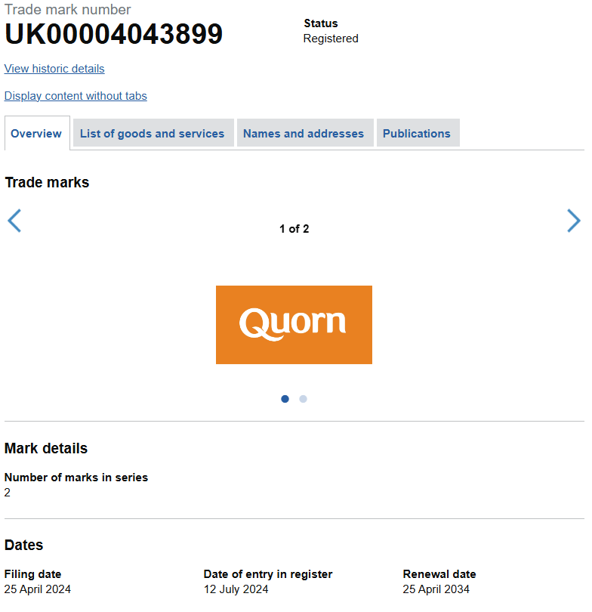
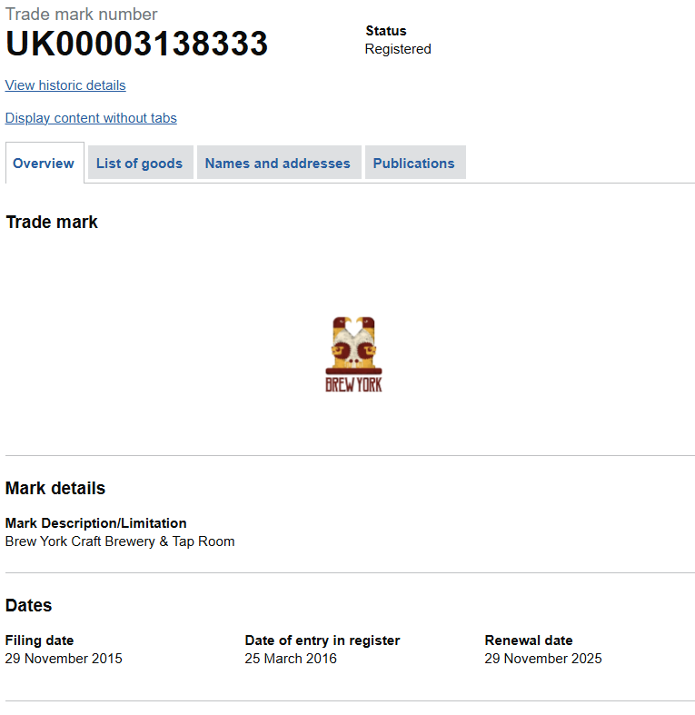
Trade marks
secerna.com

Slide 15
Designs
Registered
Protects physical shape, configuration, decoration, colour, and/or pattern
Stop others from making, using or selling the design
Lasts up to 25 years
Must be novel and possess individual character
Unregistered
Automatically protects new designs
Protects against copying
Lasts up to 15 years
Must not be commonplace
secerna.com

Slide 16
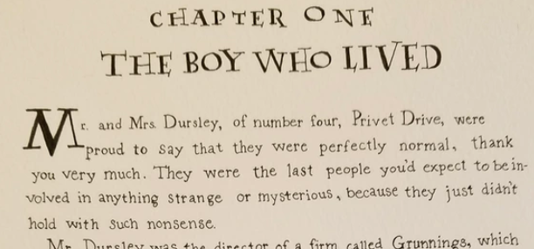
Copyright
What is copyright
Protects your creative work and stops other from using it
Applies to original:
Literary, dramatic, musical, and artistic works
Non-literary written works
Sound and music recordings
Film and television recordings
Broadcasts
Prevents others from copying your creative work
Duration varies by the type of work
secerna.com

Slide 17
Trade secrets
What are trade secrets
Protect confidential business information
No formal registration
Protected as long as the information remains secret
Must be actively safeguarded
secerna.com

Slide 18
How to identify IP assets (1)
Identifying IP assets
Types of IP assets
Regular reviews
Documentation
secerna.com

Slide 19
How to identify IP assets (2)
Verification of ownership and rights
Due diligence
Legal transfers
Ownership records
secerna.com

Slide 20
How to identify IP assets (3)
Assessment of IP protection
IP audits
Protection strategies
Legal compliance
secerna.com

Slide 21
IP Advance (funding!)
UKIPO’s IP Advance scheme
Supports SMEs with IP strategy and implementation
IP Audit:
Part-funding of £2,250 with the business contributing of £750
Receive bespoke IP audit report and follow-up meeting
IP Access:
Up to £2,250 for IP professional advice to progress and IP management strategy or implement recommendations from IP audit.
Business must contribute minimum of 50% towards costs.
Can apply for one or both levels
In England, IP Advance delivered through Innovate UK Business Growth
secerna.com

Slide 22
Developing an IP strategy (WHEN, WHERE and HOW)

Slide 23
When to protect?
Early in development
Before public disclosure
During product development
Before market entry
secerna.com

Slide 24
When to protect?
No action to register your IP
Limited market scope
Uncertain market viability
Trade secrets as an alternative
secerna.com

Slide 25
Where to protect?
Factors to consider for effective and strategic protection
Market presence
Competitors
Manufacturing locations
Cost
Legal environment
Strategic importance
secerna.com

Slide 26
How to protect?
Registering IP rights
Registration needed | Registration not needed
Patents | Unregistered designs
Registered designs | Unregistered trade marks
Registered trade marks | Copyright
secerna.com

Slide 27
Registering patents
Filing
Search
Examination
secerna.com

Slide 28
Typical patent filing timelines
Route 1
National applications`
Priority application
International application
National applications
Route 2
T = 0
T = 12m
T = 30m
secerna.com

Slide 29
Registering designs
Filing
Examination
Registration
secerna.com

Slide 30
Registering trade marks
Filing
Examination
Registration
secerna.com

Slide 31
IP infringement

Slide 32
Defending your IP rights
Identify the infringement
Evaluate the impact
Consider enforcement options
Assess IP ownership
©2025 SecernaLLP
Patented GB1234567
secerna.com

Slide 33
Avoiding IP infringement
Conduct research
Respect confidentiality
Use original content
Education
secerna.com

Slide 34
Summary: checklist
Protecting your IP rights
Understand types of IP rights
Identify IP assets
Verify ownership
Assess IP protection and identify gaps
Developing an IP strategy
Consider timing for IP protection
Decide where to protect your IP
Understand how to protect your IP rights
IP infringement
Understand what constitutes IP infringement
Are you an IP right holder or potential infringer?
secerna.com

Slide 35
Summary: final remarks
*** Seek legal advice at an early stage ***
secerna.com

Slide 36
Thank you for listening
Any questions?
mansell@secerna.com
docketing@secerna.com

