Slide 1



Harnessing the power of communications to promote and grow your business
Turn outreach into sales
heyme.co.uk

Slide 2


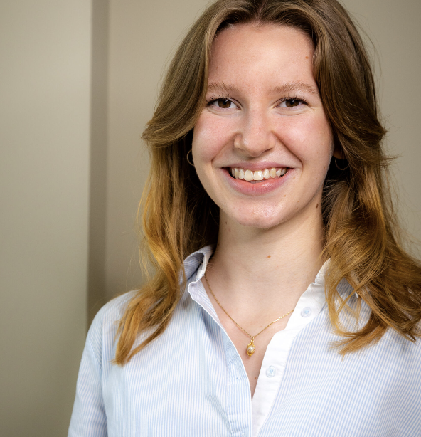

Your Hey Me Team
40+ years combined experience
Amy
Emma
Molly
Katie
Founder and
Managing Director
Senior Communications Manager
Communications
Executive
Business Support
Manager

Slide 3


What promotional activity are you currently doing and is it fit for your audience?
you

Slide 4
HEALTH CHECK
CRAFT YOUR MESSAGE
CUT THROUGH THE NOISE
  Review business plan
  Auditing existing comms vs competitors
  Audience benchmarking
  Culture
  Personality
  Messaging
  Tone
  Tailored communications
  Channel
  Method
  Timings and frequency

Slide 5

Communications Audit
What is it?
A health check for your business
Why do you need communications
Who are you talking to?
What are you saying?
How are you saying it?
Where are you saying it?
Is it working?

Slide 6

Audit
Looking back and stepping forward

Slide 7

Be clear!
Who are you
What do you do
What you want.

Slide 8

Who are you talking to?
Who are you trying to reach?
What do they need/ want to know?

Slide 9

Readiness to buy
Do they know they have a problem?
Do they know there’s a solution?
Do they know where to look?

Slide 10

How are you saying it?
Are you giving your audience added value?
Are you speaking the right language?
Are you giving your audience a reason to believe?

Slide 11
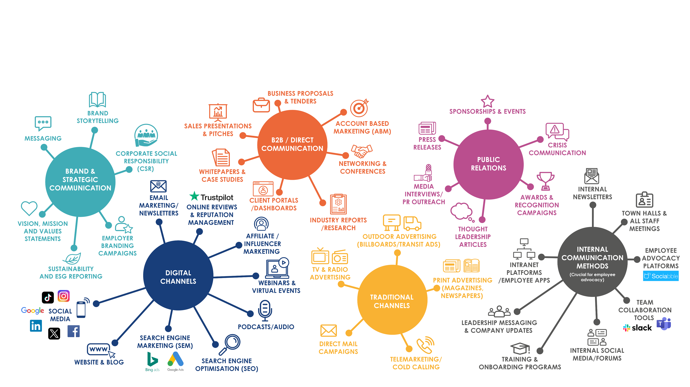
Where are you saying it?

Slide 12

Is it working?
Keep the intention in mind
Look at trends over time
What triggers action and at what level: browsing, enquiries or sales
How long does it take
What’s the cost per lead

Slide 13

Where does your audience
hang out?
Where does your audience get their information?
What sources do they use?
Which sources do they take more seriously?

Slide 14

What’s grabbing their attention?
If not you then who?
If not you then what?
Is there anybody in between you and them?

Slide 15

Using your learning
Follow these 7 simple steps:
Know your intentions
Know your audience
Tailor your message to your audience needs
Give them a reason to believe
Choose the right tools
Is it easy
Ask “So what?”

Slide 16
Health Check
FINDING YOUR VOICE
CUT THROUGH THE NOISE
  Review business plan
  Auditing existing comms vs competitors
  Audience benchmarking
  Culture
  Personality
  Messaging
  Tone
  Tailored communications
  Channel
  Method
  Timings and frequency

Slide 17

What’s next?
Craft your message
Thursday 26th February
10am – 11am
email amy@heyme.co.uk
LinkedIn https://www.linkedin.com/in/amyjbell/
LinkedIn Hey Me
https://www.linkedin.com/company/hey-me
heyme.co.uk

