Slide 1
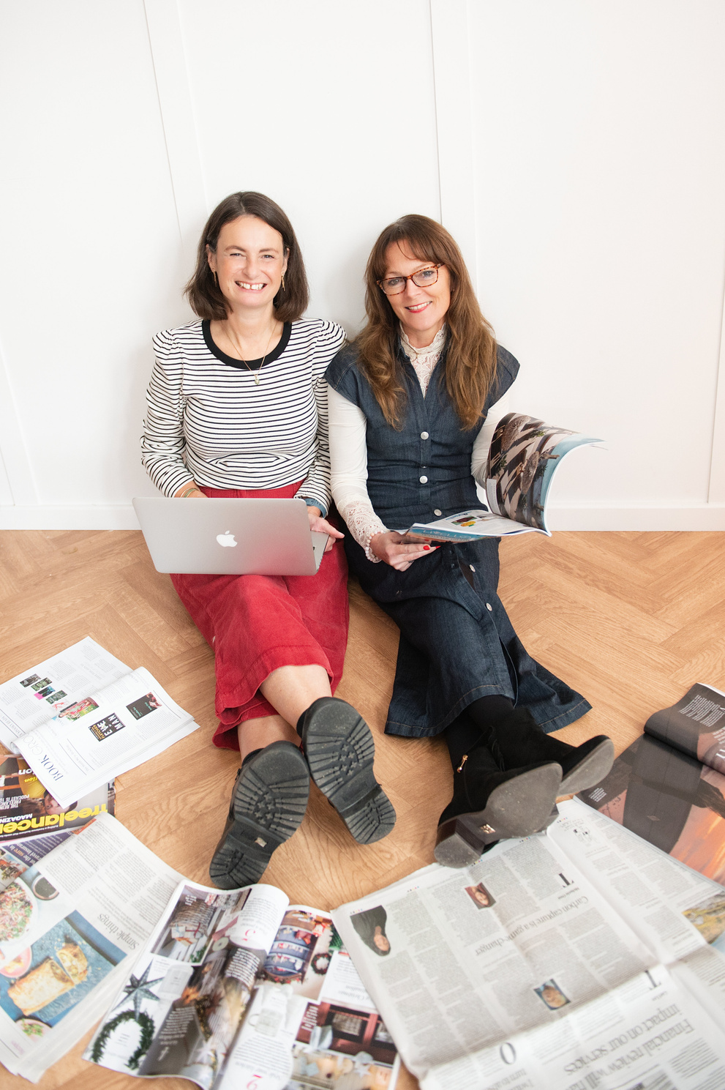
PR FOR SMALL BUSINESSES
WITH LINDA & JO
While we’re waiting for everyone to join, introduce yourself in the chat:
• Your name
• Business name
• Social media/website
• Dream publication where you’d love to see your business featured
www.lindaharrison.co.uk www.joleathampr.co.uk

Slide 2

THANK YOU...
...to the York & North Yorkshire Growth Hub for supporting this PR webinar!

Slide 3

LET’S START WITH SOME PR QUESTIONS
  If your business was a headline, what would it say?
  What’s one word you’d love people to associate with your business?
  What’s the most unusual/surprising thing about your business that people don’t usually know?

Slide 4

WHAT YOU’LL LEARN IN TODAY’S SESSION
• What PR is - and how it’s different to marketing & advertising
• Why you need PR
• How the media works
• What makes a story
• How to pitch journalists
Plus: Q&A

Slide 5
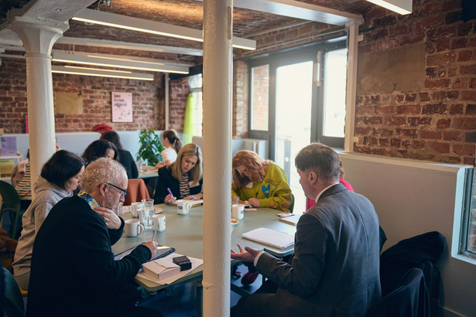
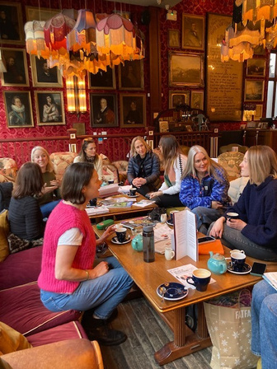
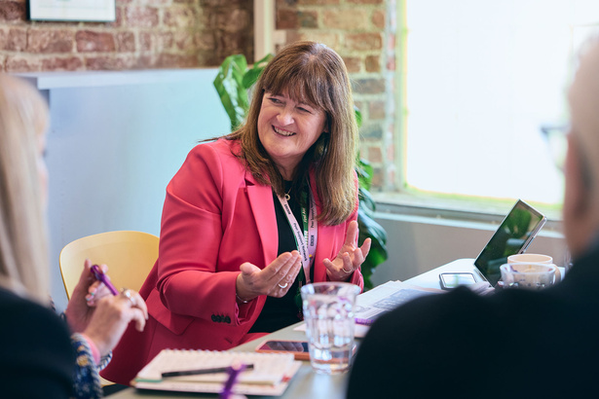
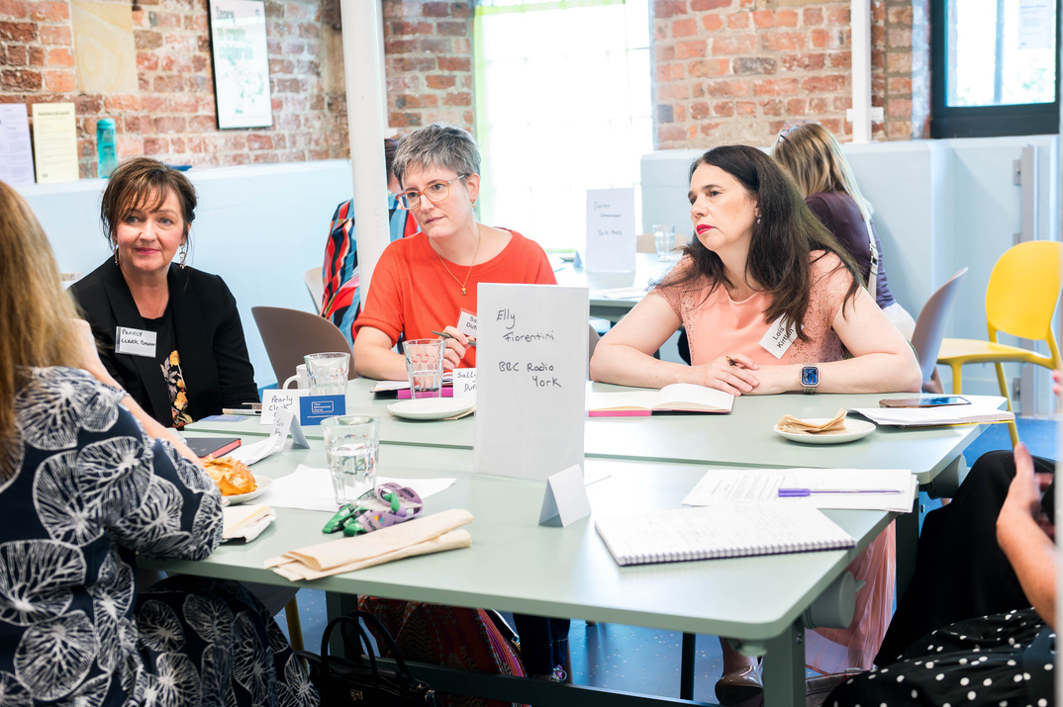
OUR PR EVENTS
Meet The Media
Free Monthly PR Coffee Mornings
PR training and workshops

Slide 6
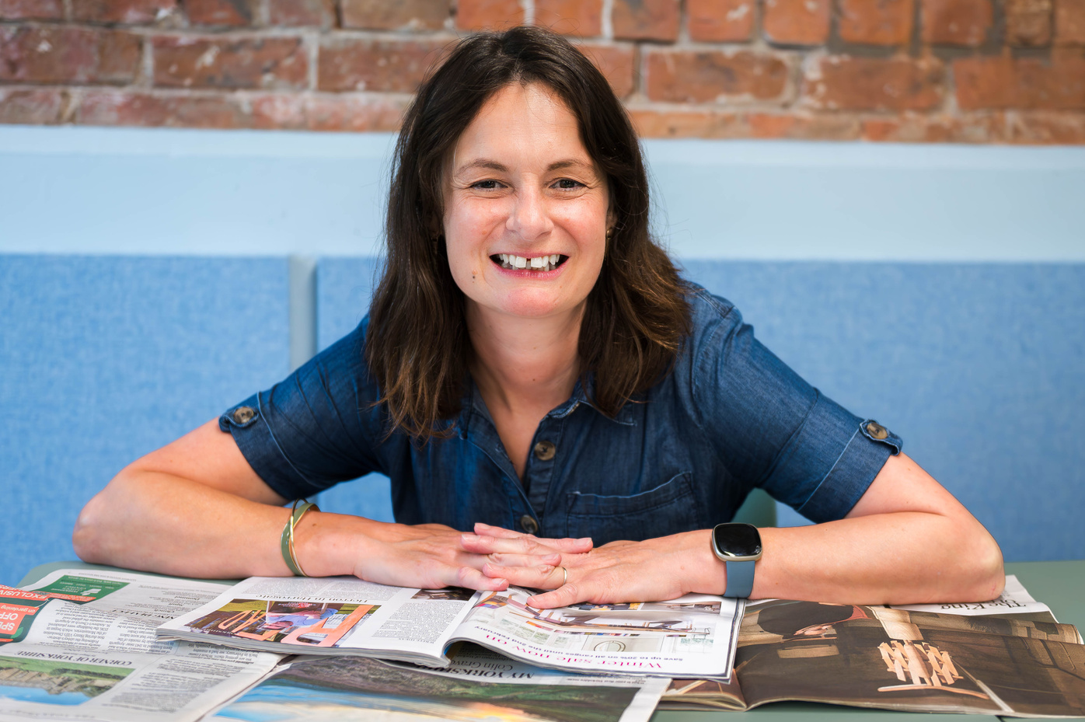
ABOUT LINDA HARRISON
NCTJ-qualified journalist.
Has written for The Daily Telegraph, The Guardian and The Daily Express.
Loves using her skills and experience to help small businesses in Yorkshire get seen in the press.
💡 Top PR tip: Always read the publication before you pitch an idea.
www.lindaharrison.co.uk

Slide 7
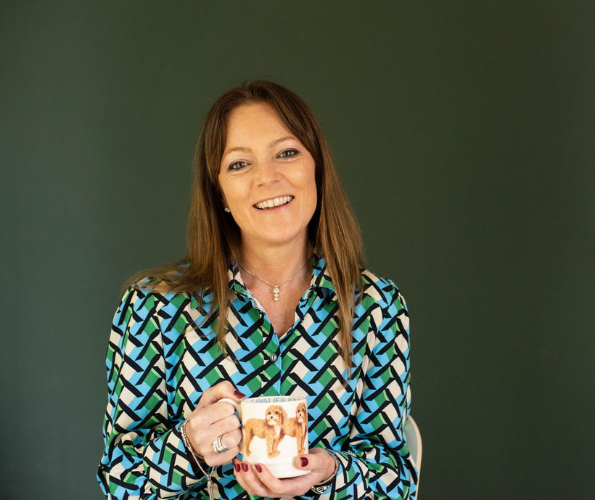
ABOUT JO LEATHAM
Has worked in the industry for 30-years.
Has provided PR support for national organisations including Nestle, Silver
Cross and Marie Curie.
Loves helping to spread the word about businesses.
💡 Top PR tip: Always respond to journalists in a timely manner and never miss a deadline.
www.joleathampr.co.uk

Slide 8

The Yorkshire Post, Yorkshire Living, Yorkshire Life, Living North, BBC Radio York, BBC Look North, ITV Calendar, The York Press, York Mix, The Daily Telegraph, The Sun, Saga, Hello! online, Yorkshire Businesswoman, The Yorkshire Times, Handpicked Local, Sussex Living, Good Housekeeping, House Beautiful, Woman magazine, and Prima - among many others...!

Slide 9
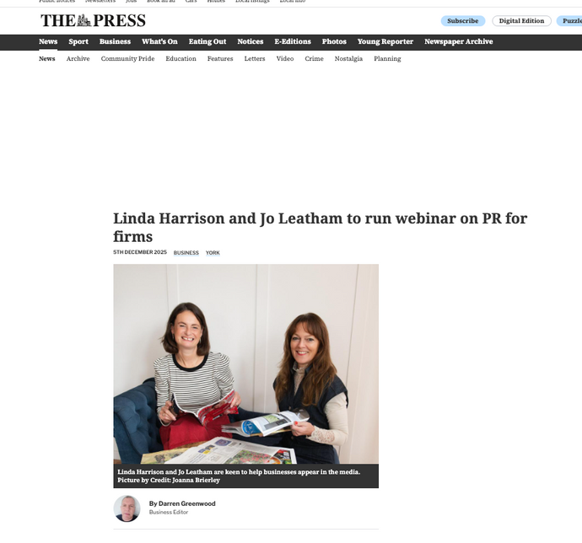
WHAT IS PR?
• PR - getting stories in the media - journalists writing about your business.
• Marketing - speaking directly to potential customers, e.g. social media.
• Advertising - paying for adverts.
Why do I need PR?
• Builds credibility and trust.
• Tells lots of people about what you do.
• Highly cost effective. PR is free - all it takes is your time.
• Great for SEO!
• REPRODUCED COURTESY OF THE YORK PRESS

Slide 10

HOW DOES THE MEDIA WORK?
• Journalists need you to approach them with story ideas.
• PRs act as the ‘middle-person’ between journalists and businesses.
• Journalists often cover specialist areas, like
business, health or what’s on.
• Top tip: Google Alerts are a great way to keep an
eye on press coverage.

Slide 11

WHAT MAKES A STORY?
• A new product or service launch
• Your backstory - why did you set up your business?
• Awards
• Sharing your knowledge - you are the expert at what you do!
• Trends - and stories in the news
• Supporting a charity
• Something quirky or different
• Case studies

Slide 12
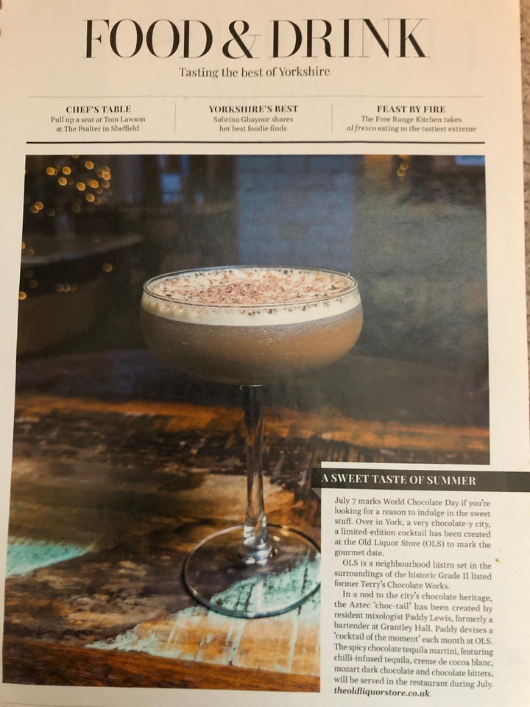
NEW PRODUCT STORY
OLD LIQUOR STORE
• REPRODUCED COURTESY OF
YORKSHIRE LIFE MAGAZINE

Slide 13
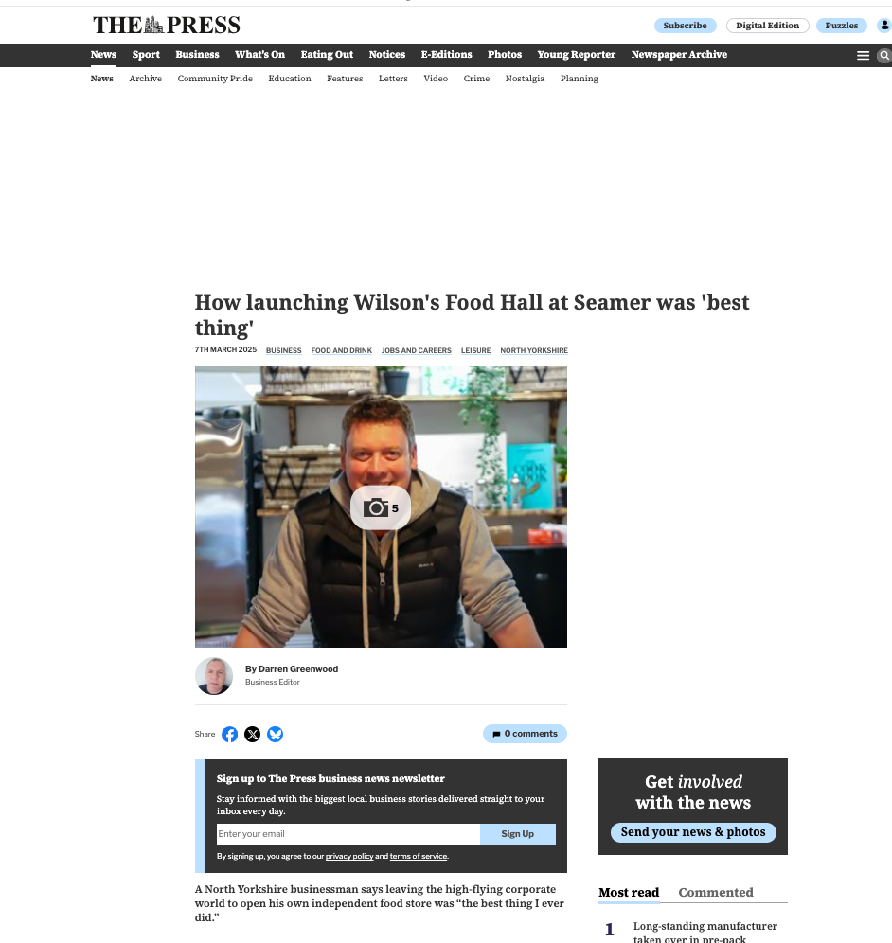
FOUNDER STORY
ADRIAN WILSON
• REPRODUCED COURTESY OF
THE YORK PRESS

Slide 14

AWARD STORY
BABY BAND
• REPRODUCED COURTESY OF
THE YORK PRESS

Slide 15
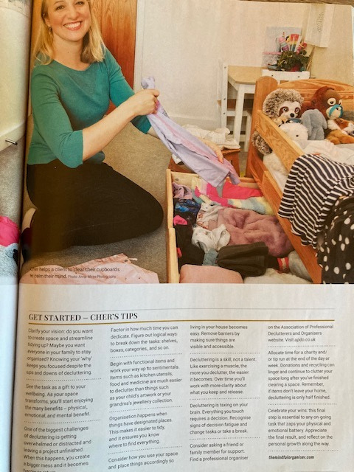
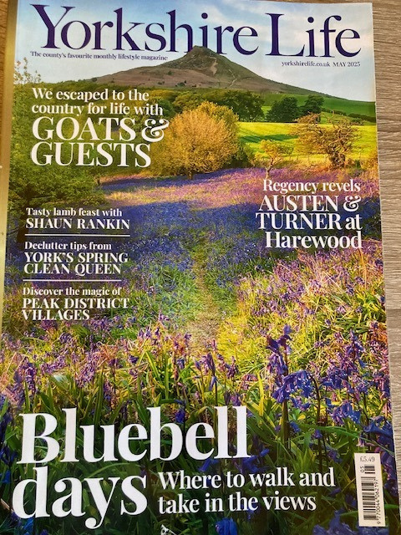
EXPERT ADVICE/TOP TIPS FEATURE
CHER CASEY
• REPRODUCED COURTESY OF YORKSHIRE LIFE MAGAZINE

Slide 16
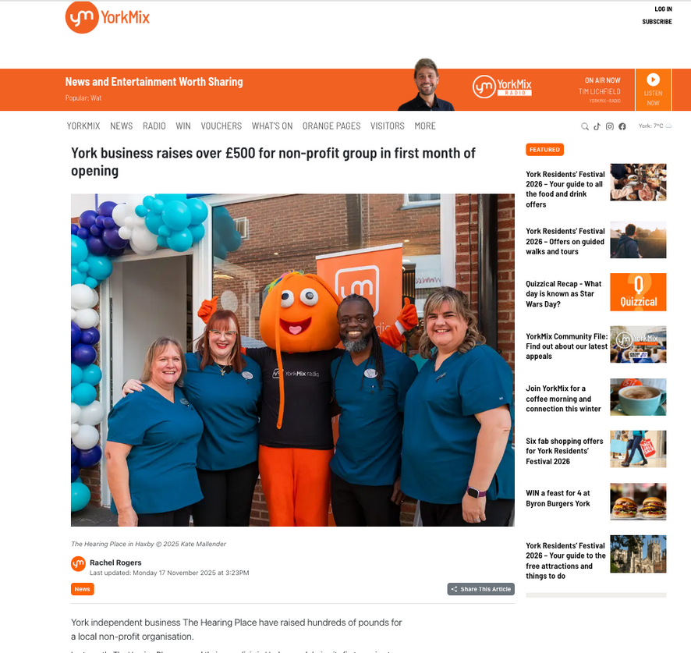
CHARITY STORY
THE HEARING PLACE
• REPRODUCED COURTESY OF YORK MIX

Slide 17

QUIRKY STORY
HETTY & BETTY
• REPRODUCED COURTESY OF THE YORK PRESS

Slide 18
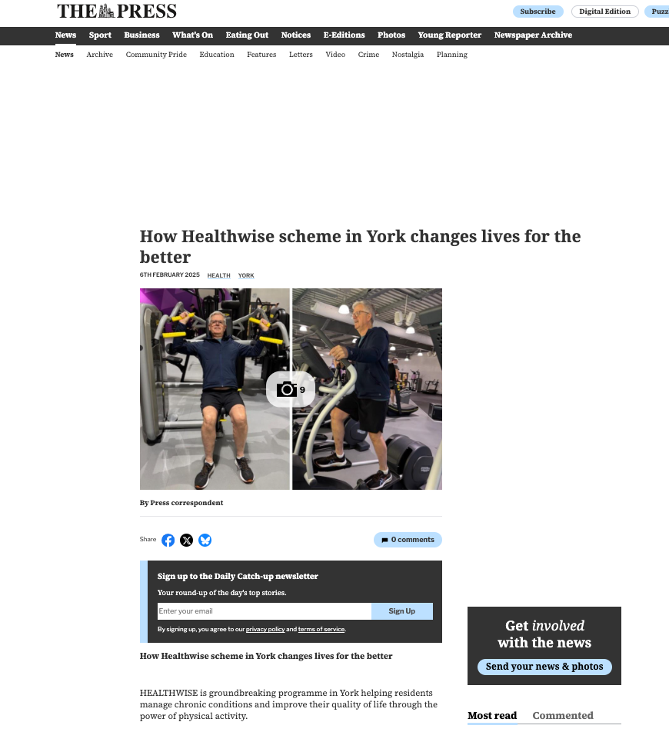
CASE STUDY STORY
HEALTHWISE PROGRAMME
• REPRODUCED COURTESY OF THE YORK PRESS

Slide 19

HOW TO PITCH YOUR IDEA TO JOURNALISTS
• Keep your email brief - five or six paragraphs max.
• Focus on who, what, where, how and why.
Why should journalists care about this story?
And why NOW?
• Make it newsworthy.
• Pictures are key!
• Sum up the story in your email subject.

Slide 20


Slide 21
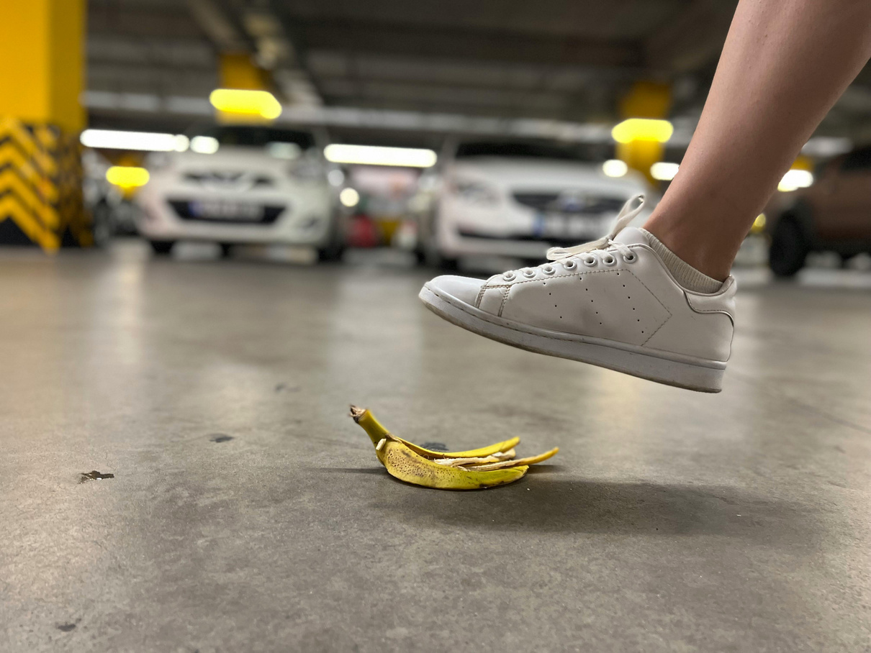
COMMON MISTAKES TO AVOID
• Making your emails too long.
• Using jargon.
• Not reading the publication.
• Misspelling the journalist’s name.
• Pitching too close to deadline.
• Not following up on pitches.

Slide 22
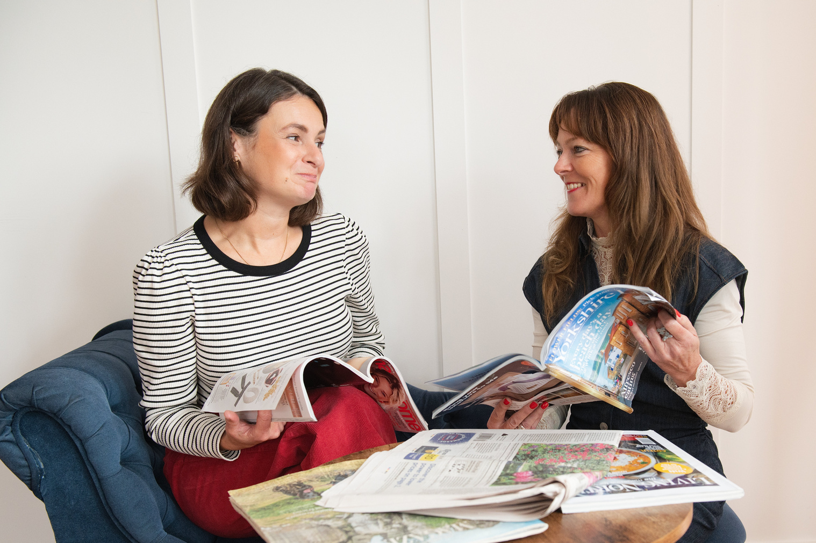
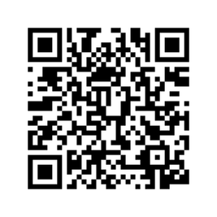

QUESTION TIME!
Get in touch
Jo: www.joleathampr.co.uk
Linda: www.lindaharrison.co.uk
• Find us on LinkedIn and Instagram
• Subscribe to Linda’s free newsletter

