Slide 1


Carbon Literacy Learning for SMEs

Slide 2
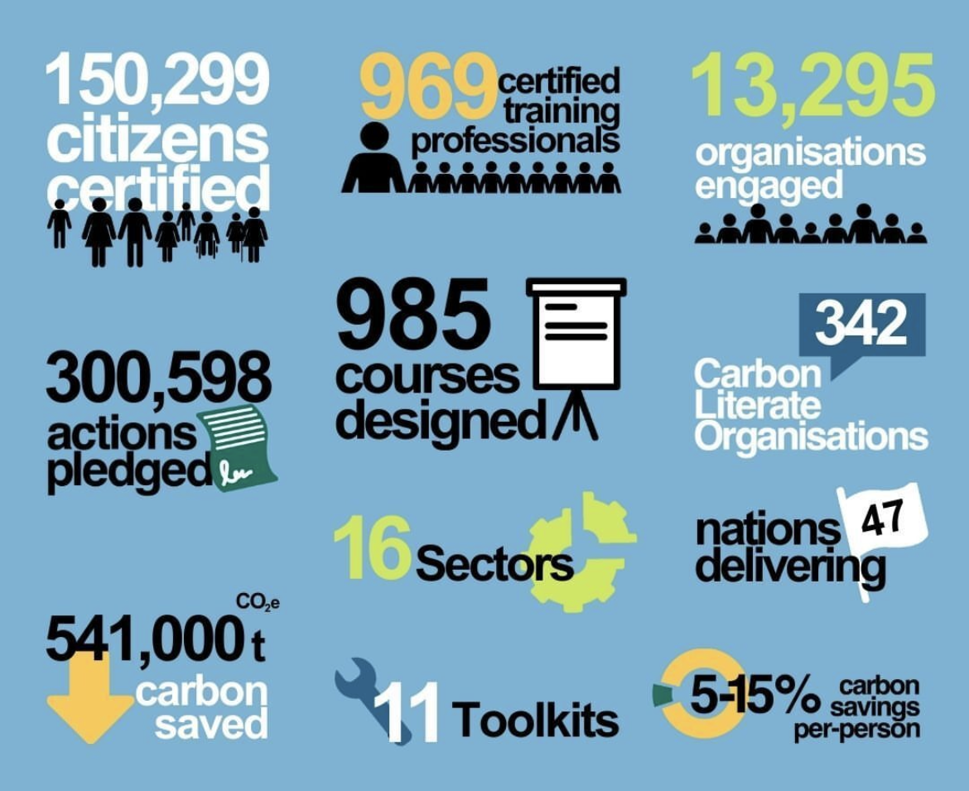


The Carbon Literacy Project: Get certified Climate Literate & become part of the movement

Slide 3
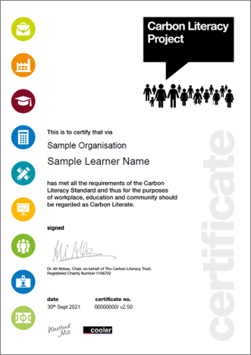

Carbon Literacy Certification What does it involve?
1. One full day of learning accredited by The Carbon Literacy Project
2. Commit to Action: Design and commit to your own specific carbon reduction actions

Slide 4


Course Objectives
1. Establish Climate Change Fundamentals
2. Understand Climate Policy & Protest
3. Destigmatise Climate Goals & Measurement
KNOWLEDGE
4. Take Individual Climate Action
5. Take Business Climate Action
6. Become a Confident Climate Communicator & Collaborate
ACTION

Slide 5
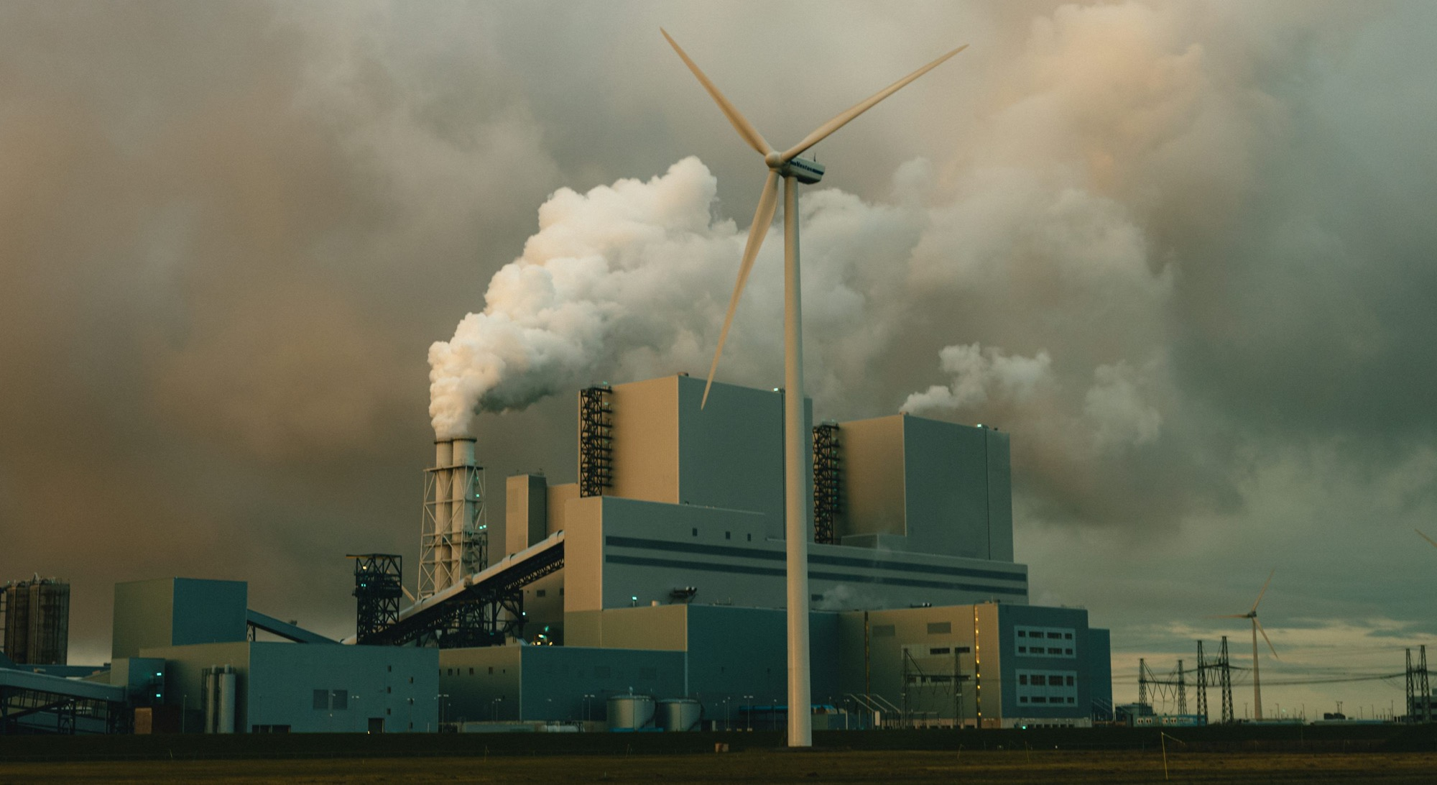

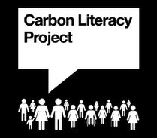
1. ESTABLISH CLIMATE CHANGE FUNDAMENTALS
Wherever you are on your climate journey, deep-dive into the causes & impacts of our Anthropocene climate crisis to understand key emissions drivers and put the fire in the belly for climate action, personally & professionally.
What is the greenhouse effect? What are the greenhouse gases and which are most potent? Why are we so confident in the science? What are the impacts of climate change on people & planet?

Slide 6
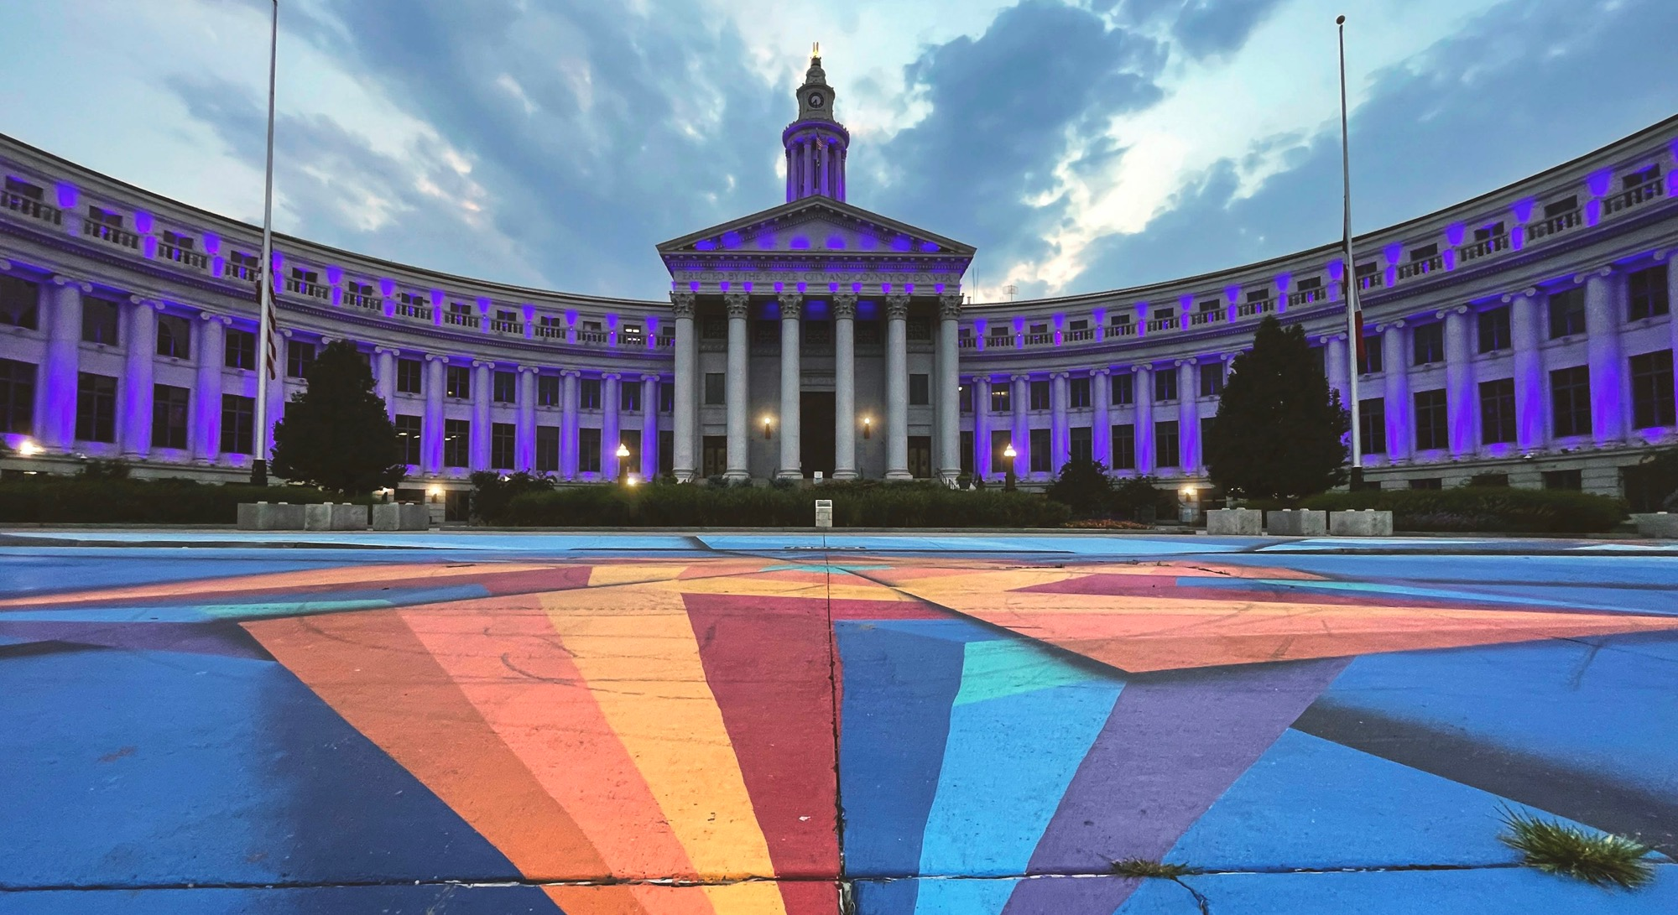

2. UNDERSTAND CLIMATE POLICY
What is the global policy landscape on climate and what’s happening in the UK and likely to impact SMEs? We’ll talk about COPs (Conference of the Parties), the UK Climate Change Act of 2008, the UK Decarbonisation Plan, Sustainability Reporting, legislation for SMEs and what’s happening more locally.
This section is designed to give you understanding of how we got to where we are today and how the future might shape, through the lens of policy. It’s important grounding for individuals & businesses.

Slide 7


3. DESTIGMATISE CLIMATE GOALS & MEASUREMENT
“What gets measured gets done!”
Learn the lingo of Net Zero & Carbon Footprinting, at an individual and organisational level. What does it mean to pledge to Net Zero? How does that differ from Carbon Neutral? Should we be offsetting? What do we mean by Scope 1, 2 & 3? Where do I start?!

Slide 8
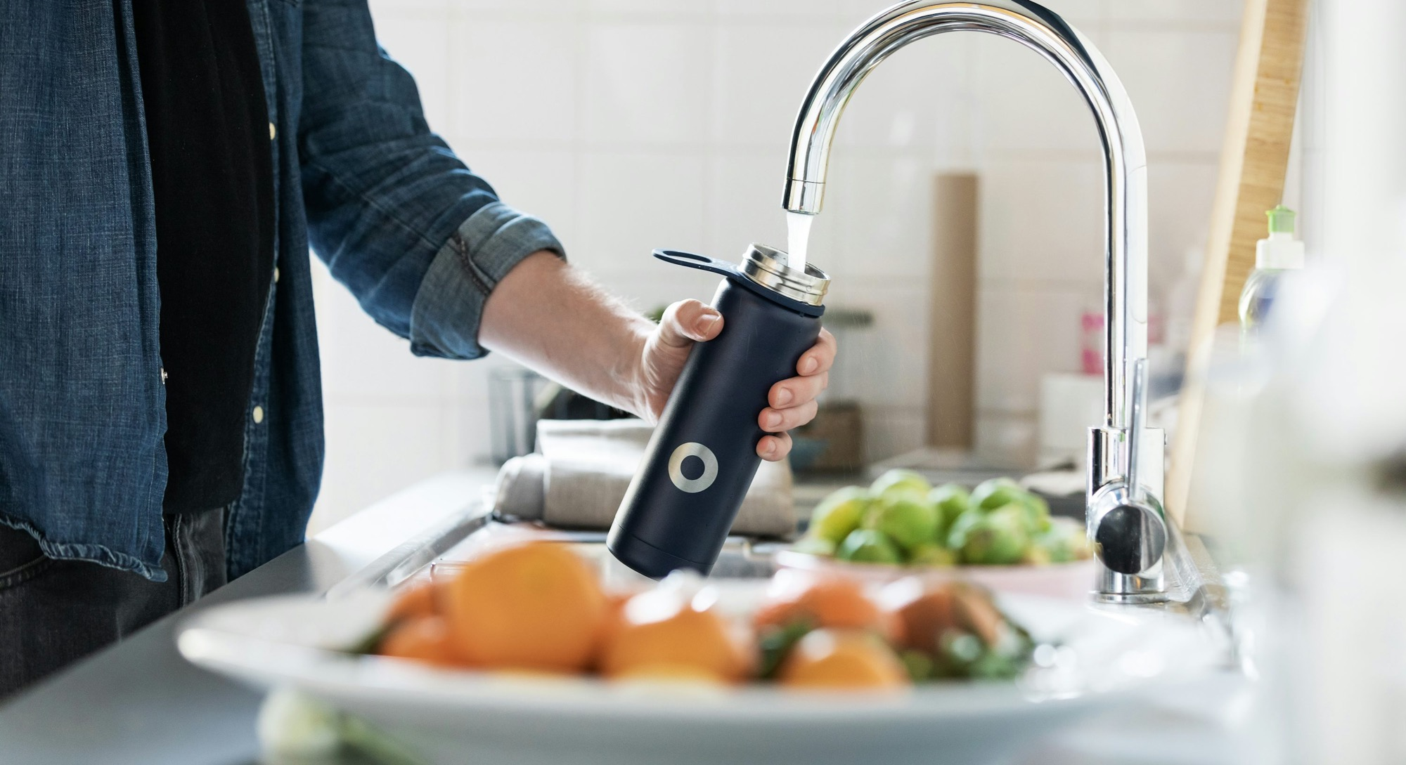

4. TAKE INDIVIDUAL CLIMATE ACTION
Looking at our own personal footprints through the lens of GIKI and our own key levers of change, focusing on Food, Transport & Energy.

Slide 9
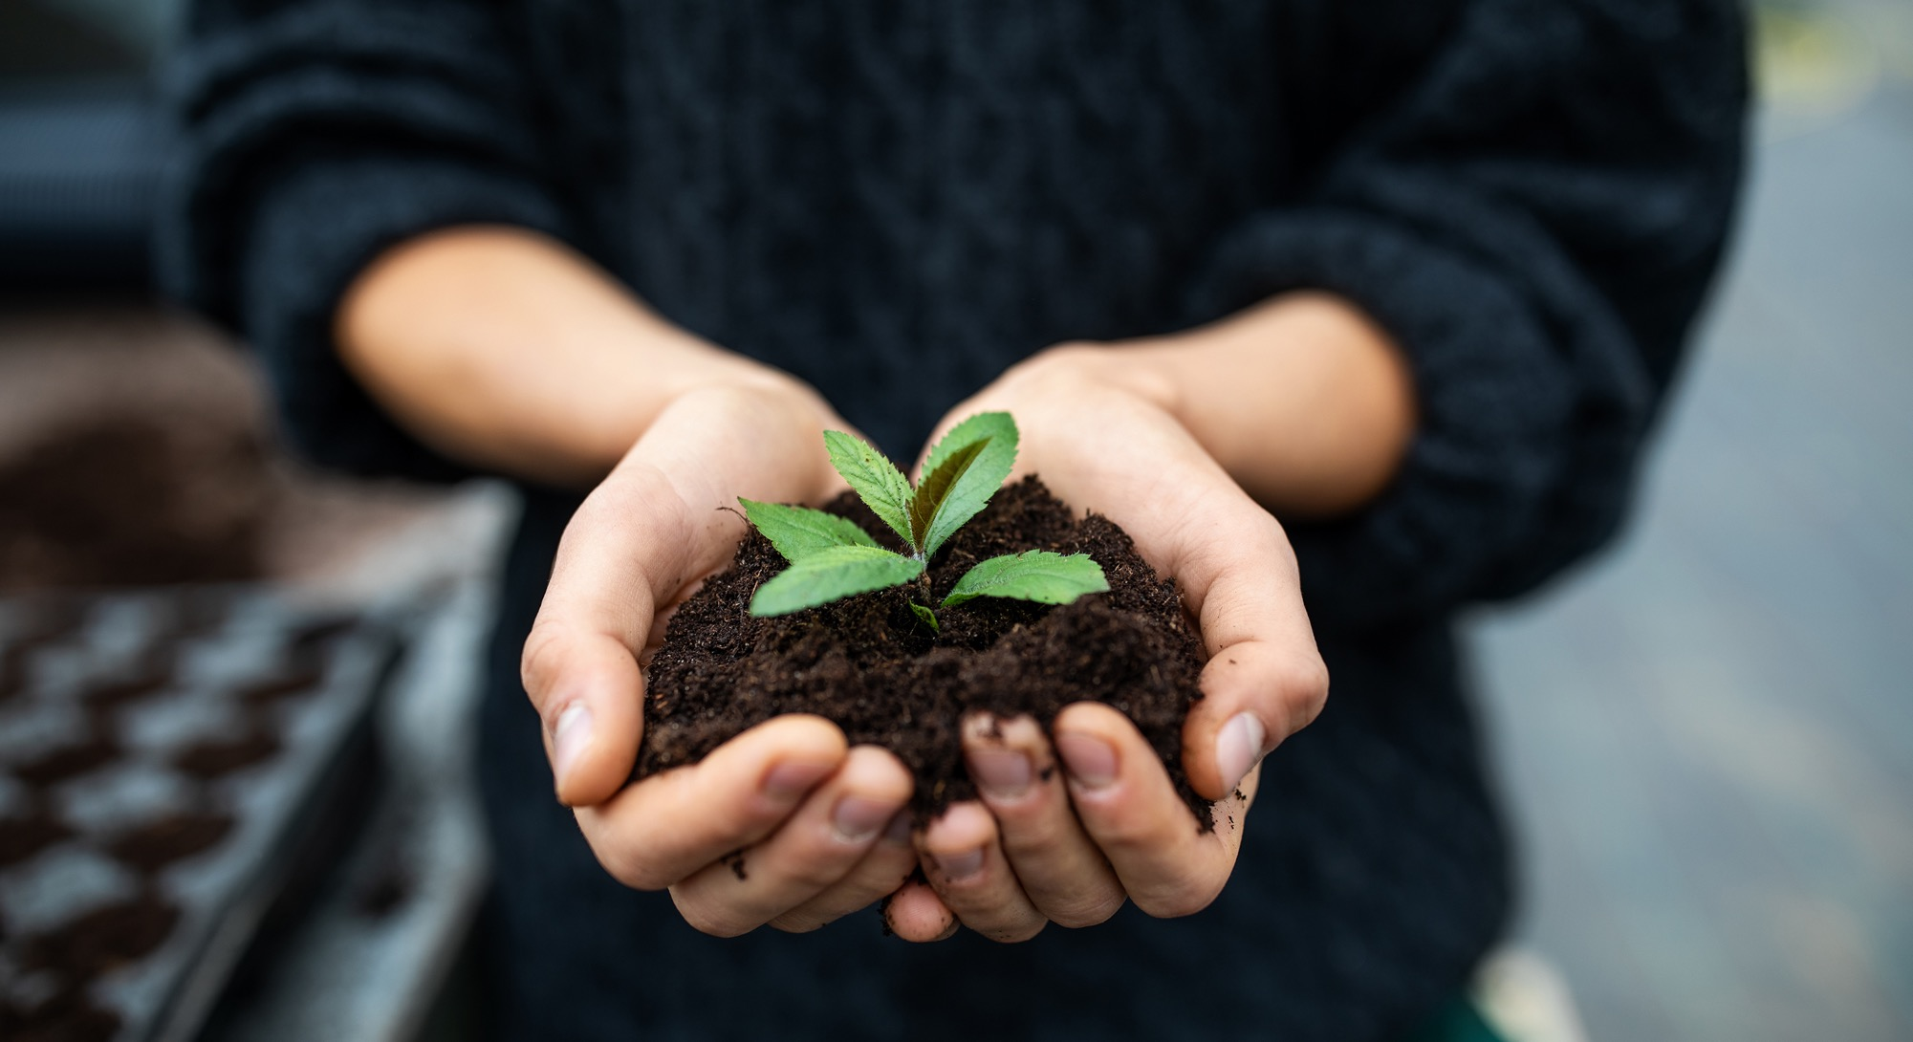

5. TAKE EMPLOYEE & BUSINESS CLIMATE ACTIONS
Looking at the 7 SME Steps to Net Zero, from leadership engagement to building a climate transition plan.
This will help tackling climate change and emissions as an organisation and employee seem more feasible, approachable, logical and bitesize for SMEs, giving clarity on where to start and the stepping stones on the journey to Net Zero.

Slide 10


6. CONFIDENT CLIMATE COMMUNICATORS
Exploring what it takes as an individual and as an organisation to talk confidently about climate change and climate action and how to positively influence others, touching on impact reports, social media, websites, tone of voice & good old-fashioned face to face conversations.

Slide 11

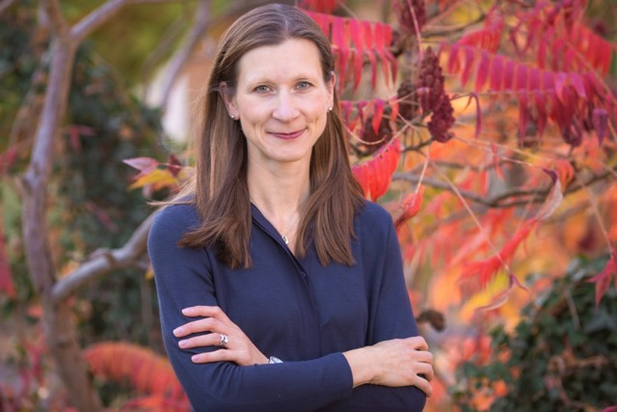

Ali Fisher – Sustainability& Diversity Business Mentor
Founded Plans With Purpose in 2017
Mission to put regeneration at the heart of business growth
Personal purpose is to spark change that matters
Certified facilitator with the Carbon Literacy Project
Studies include:
Cambridge University Institute of Sustainability Leadership Business Sustainability Management Course
Doughnut Economics Action Lab (DEAL) Doughnut Design for Business Training
Trained B-Corp B-Leader
UCL Behaviour Change Course
Finalist in The Business Culture Awards Consultancy of the Year (2025), Highly commended in The Dynamic Awards for Inspiration (2025) & Finalist in Surrey Business Awards Chamber Member of the Year (2025)
Volunteer / Supporter with Zero Carbon Guildford, Surrey Climate Commission, Guildford Lions, LEAD Network UK Chapter, Disability Challengers & Goal 17
Donates 2% of all business project fees to charity

Slide 12

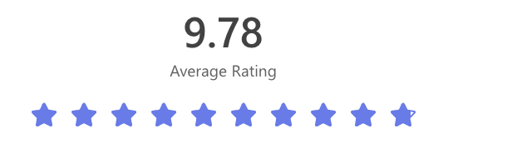
Course Reviews
“High quality trainer. Great real breadth of coverage and a good understanding of how we can assess our personal and business activities and look to reduce emissions.”
“Very thorough and interesting course delivered by Ali. It’s given me a great basis of understanding and will be useful to apply to business and personal activities in order to achieve net zero in the future. I would definitely recommend for anyone starting the journey.”
“A fantastic course engagingly delivered by Ali. Despite having a background in this topic I learnt a huge amount, and it has really helped me refocus my activities within my own organisation. I now have multiple concrete steps I can take to improve the sustainability of the organisation, with many of these in areas I had not even considered prior to taking the course. Thanks Ali!”

Slide 13
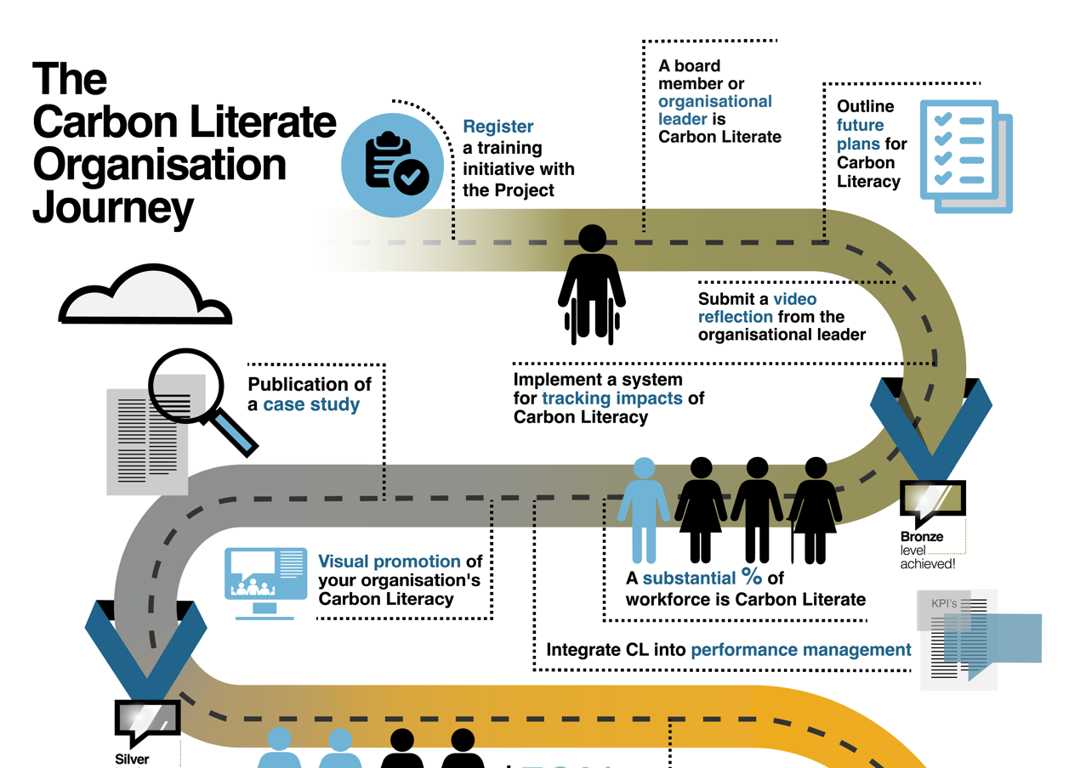
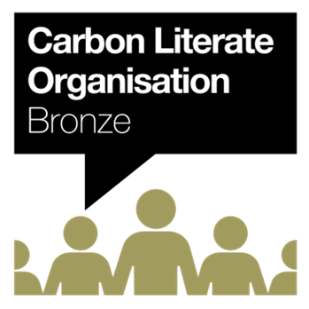
Consider becoming a Carbon Literate Organisation
Key steps to becoming Bronze certified Carbon Literate Organisation
One trained Board member
Commit to an on-going carbon literacy plan, eg training more team members & any new starters
Film & share a short leadership video on Carbon Literacy & why it matters for your organisation (clear guidelines given)
Track carbon literacy outputs & actions (good practice anyway to ensure real progress)

Slide 14
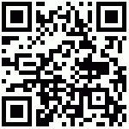
Find out more about Carbon Literacy Training with Plans With Purpose here:

