Slide 1


Data Analytics Webinar: Basic Data Literacy Skills

Slide 2
WHY THIS SERIES EXISTS?

Slide 3
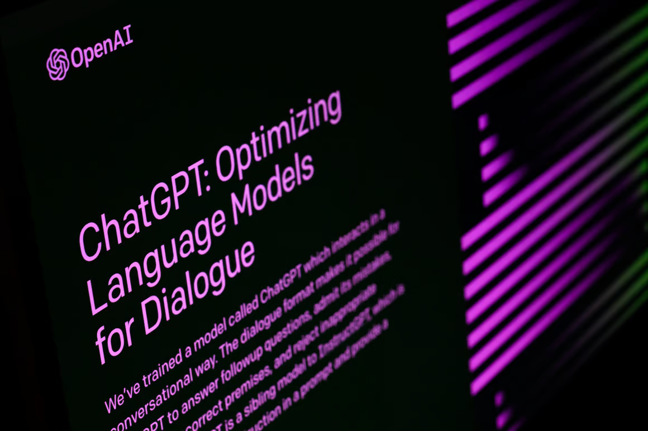
Notes:
ChatGPT probably created the largets spike in AI interest for the past few years. Before that we had jeopardy champions and AlphaGo. The interest has been mounting since the age of Big Data in the early 00's and has led to development of algorithms and tech capabilities.

Slide 4
WHY YOU SHOULD TAKE DATA SERIOUSLY
EVIDENCE BACKED DECISIONS NOT GUT FEELING
THE RISE OF AI, BETTER DATA EQUALS BETTER MODELS
THE NEW STRATEGIC ADVANTAGE, EVERYONE WILL SOON HAVE AI BUT NOT EVERYONE WILL HAVE YOUR DATA

Slide 5

Notes:
Data Strategy is an extension of your existing corporate strategy.

Slide 6
DATA SOURCES
INTERNAL SOURCES:
CRM (CUSTOMER RECORDS)
ERP (SALES, STOCK, FINANCE)
HR SYSTEMS
WEB ANALYTICS
EMPLOYEE FEEDBACK
EXTERNAL SOURCES:
INDUSTRY REPORTS
SOCIAL MEDIA
MARKET TRENDS
GOVERNMENT OPEN DATA
SUPPLIER AND PARTNER DATA

Slide 7
DATA TYPES
STRUCTURED
NUMBERS
DATES
TRANSACTIONS (E.G., EXCEL, DATABASE TABLES)
UNSTRUCTURED
TEXT, IMAGES, EMAILS, DOCUMENTS
SEMI-STRUCTURED
JSON, XML, SENSOR LOGS

Slide 8
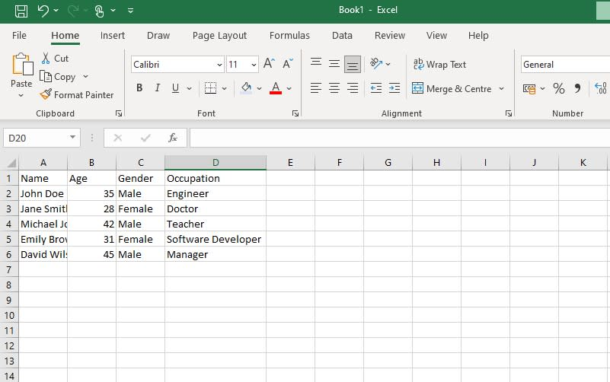

Slide 9
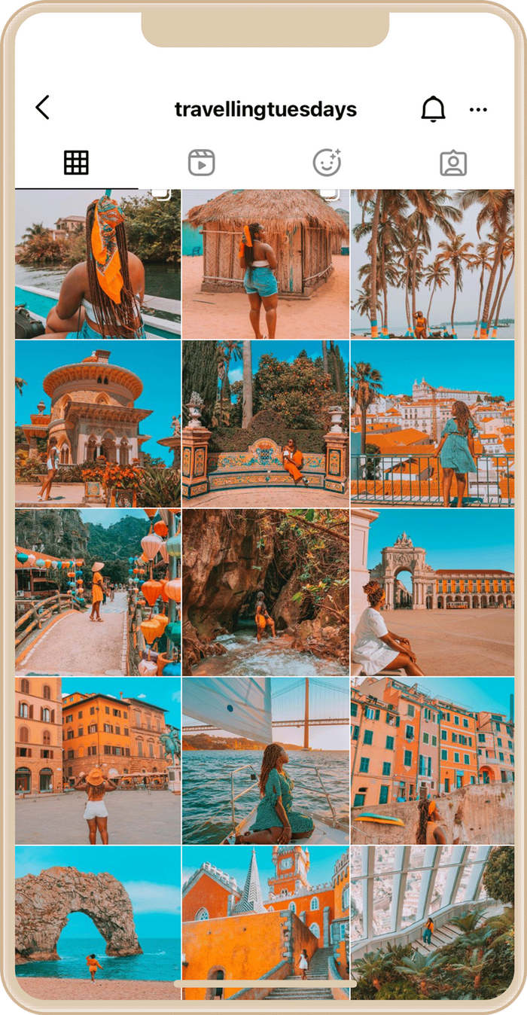

Slide 10
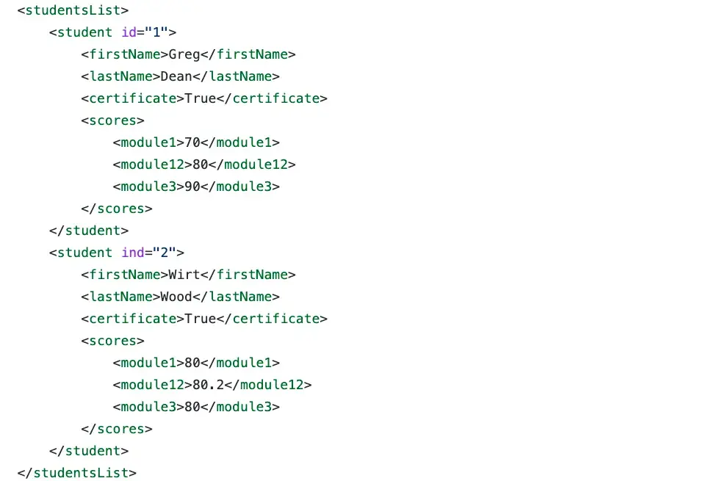

Slide 11
WHAT IS THE SCIENTIFIC METHOD?

Slide 12
WHAT IS THE SCIENTIFIC METHOD?
QUESTION
RESEARCH
HYPOTHESISE
TEST
EVALUATE
DECIDE

Slide 13
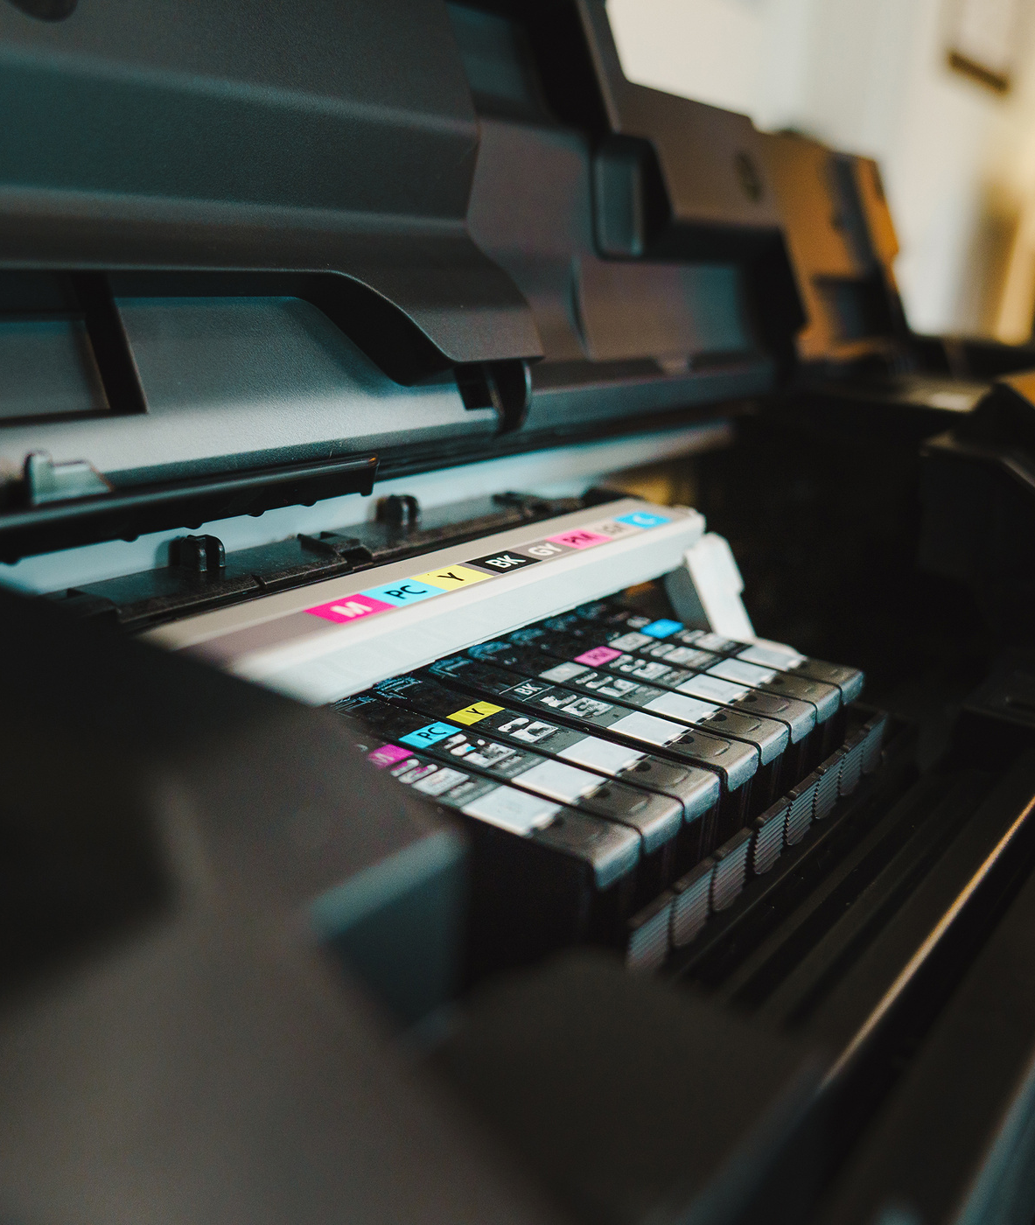
Scenario
Sales have plateaued, and the team wants to focus efforts on the most valuable customers.
Management believes all customers should be treated equally to protect relationships, but the sales team suspects that focusing on high-value accounts could yield better returns.
Notes:
AI is an umbrella term for a lot of different tools, and due to an absence of an agreed upon definition, a lot of tools get thrown in with AI when this isn't strictly the case.
Due to an abundance of tools available on the market, it is really hard to use the right tools for the right job especially when the required knowledge and understanding is lacking. It's easy to just see GenAI as the silver bullet that will solve all an organisations issues.
To get a single tool to do; chatbots, image generation, computer vision, speech recognition, predictive analytics, recommendation systems, autonomous systems, robotics, domain specific AI, NLP.
Not to mention complementary tools like RPA, IoT, digital twins, data management solutions like Snowflake, cloud services, ETL, CRMs, ERPs, etc. It's very hard to know what tools to turn to for your business and goal.
Another key question is, should we be using AI at all?
AI is often compared to being like a hammer looking for a problem, but what if the problem isn't a nail but a screw? So much time spent looking for the best tool to use, with little time looking at what problem it needs to solve.

Slide 14
Customer ID | Sales Volume This Year (£) | Support Tickets | Support Calls | Average Resolution Time (hrs) | Support Consumables (£) | Cost of Sales Calls (£) | Missed Payment | On Stop by Finance | Cost of Delivery (£)
1 | 38079.47 | 19 | 25 | 19.87 | 274.46 | 3534.53 | 0 | 1 | 187.36
2 | 95120.72 | 10 | 7 | 10.02 | 100.87 | 4557.59 | 0 | 0 | 189.73
3 | 73467.40 | 16 | 28 | 5.95 | 342.29 | 3142.57 | 0 | 0 | 126.93
4 | 60267.19 | 7 | 25 | 67.75 | 43.93 | 1712.54 | 1 | 1 | 157.77
5 | 16445.85 | 3 | 9 | 30.29 | 69.41 | 4134.28 | 0 | 0 | 124.39
Notes:
200 customers, measuring 9 different variables to create a "profitability score"
Discuss the steps that go into turning this data into an organised list of customers ranked by their profitability score.

Slide 15
Rank | Customer ID | Sales Volume This Year (£) | Support Tickets Raised | Customer Support Calls | Average Resolution Time (hrs) | Amount Spent on Support Consumables (£) | Cost of Sales Calls This Year (£) | Missed Payment | On Stop by Finance | Cost of Delivery (£)
1 | 89 | 88834.06 | 0 | 8 | 50.30 | 50.40 | 76.01 | 0 | 1 | 69.52
2 | 108 | 75799.56 | 7 | 7 | 34.90 | 93.16 | 305.40 | 1 | 0 | 11.67
199 | 91 | 12839.83 | 13 | 43 | 63.01 | 363.05 | 1607.25 | 1 | 1 | 135.53
200 | 182 | 12233.88 | 18 | 27 | 38.76 | 443.73 | 4523.43 | 1 | 1 | 123.92
Notes:
All variables equally weighted. Managing director view.

Slide 16
Rank | Customer ID | Sales Volume This Year (£) | Support Tickets Raised | Customer Support Calls | Average Resolution Time (hrs) | Amount Spent on Support Consumables (£) | Cost of Sales Calls This Year (£) | Missed Payment | On Stop by Finance | Cost of Delivery (£)
1 | 141 | 96282.28 | 4 | 12 | 17.17 | 278.65 | 2162.74 | 1 | 0 | 192.85
2 | 89 | 88834.06 | 0 | 8 | 50.30 | 50.40 | 76.01 | 0 | 1 | 69.52
199 | 172 | 2642.20 | 15 | 22 | 71.80 | 419.89 | 591.86 | 1 | 1 | 90.44
200 | 182 | 12233.88 | 18 | 27 | 38.76 | 443.73 | 4523.43 | 1 | 1 | 123.92
Notes:
Variables weighted differently.
Sales director view, big weighting for sales compared to other variables.

Slide 17
Rank | Customer ID | Sales Volume This Year (£) | Support Tickets Raised | Customer Support Calls | Average Resolution Time (hrs) | Amount Spent on Support Consumables (£) | Cost of Sales Calls This Year (£) | Missed Payment | On Stop by Finance | Cost of Delivery (£)
1 | 111 | 29685.39 | 4 | 0 | 11.72 | 155.72 | 2961.91 | 0 | 0 | 50.07
2 | 21 | 61573.44 | 3 | 8 | 5.04 | 24.05 | 2449.65 | 1 | 0 | 96.69
199 | 109 | 23651.02 | 11 | 47 | 49.68 | 418.75 | 3366.09 | 0 | 1 | 197.41
200 | 91 | 12839.83 | 13 | 43 | 63.01 | 363.05 | 1607.25 | 1 | 1 | 135.53
Notes:
Customer Service/Support viewpoint.
So what? Would love to see things like this in board meetings.

Slide 18














MANAGING THE DATA LIFECYCLE
Clean
Analyse
Generate & Capture
Store
Present & Consume
Notes:
Where are we currently with AI? And why am I asking you to forget about it?

Slide 19
SO WHAT NEXT?

Slide 20
RECAP
DISTINGUISH BETWEEN DATA TYPES.
IDENTIFY INTERNAL AND EXTERNAL DATA SOURCES.
EXPLAIN HOW DATA CAN IMPROVE A BUSINESS PROCESS.

Slide 21
Thank You
Any Questions?

