Slide 1


Modern Project Management Tools For Automation & Productivity Gains

Slide 2

Why this session matters
  Most small businesses already “manage work”, just not in a structured way
  Spreadsheets, inboxes, WhatsApp, and memory do not scale
  Task tools aren’t just for “project managers”, they’re operational systems
Notes:
ChatGPT probably created the largets spike in AI interest for the past few years. Before that we had jeopardy champions and AlphaGo. The interest has been mounting since the age of Big Data in the early 00's and has led to development of algorithms and tech capabilities.

Slide 3
Why this session matters
  Tasks and processes often live in people’s heads
  No visibility of bottlenecks
  Work feels busy but progress is unclear
  No data on:
    Where time goes
    What causes delays
    Which work actually drives value
  If work isn’t structured, it can’t be measured.
  If it can’t be measured, it can’t be improved or automated.
Notes:
ChatGPT probably created the largets spike in AI interest for the past few years. Before that we had jeopardy champions and AlphaGo. The interest has been mounting since the age of Big Data in the early 00's and has led to development of algorithms and tech capabilities.

Slide 4
Why this session matters
  These systems generate data automatically:
    Task creation timestamps
    Status changes
    Owners and handovers
    Due dates vs completion dates
    Rework and delays
    Workload by person or team
  Every card, task or item = multiple data points
  Every data point can be leveraged for operational insight
Notes:
ChatGPT probably created the largets spike in AI interest for the past few years. Before that we had jeopardy champions and AlphaGo. The interest has been mounting since the age of Big Data in the early 00's and has led to development of algorithms and tech capabilities.

Slide 5
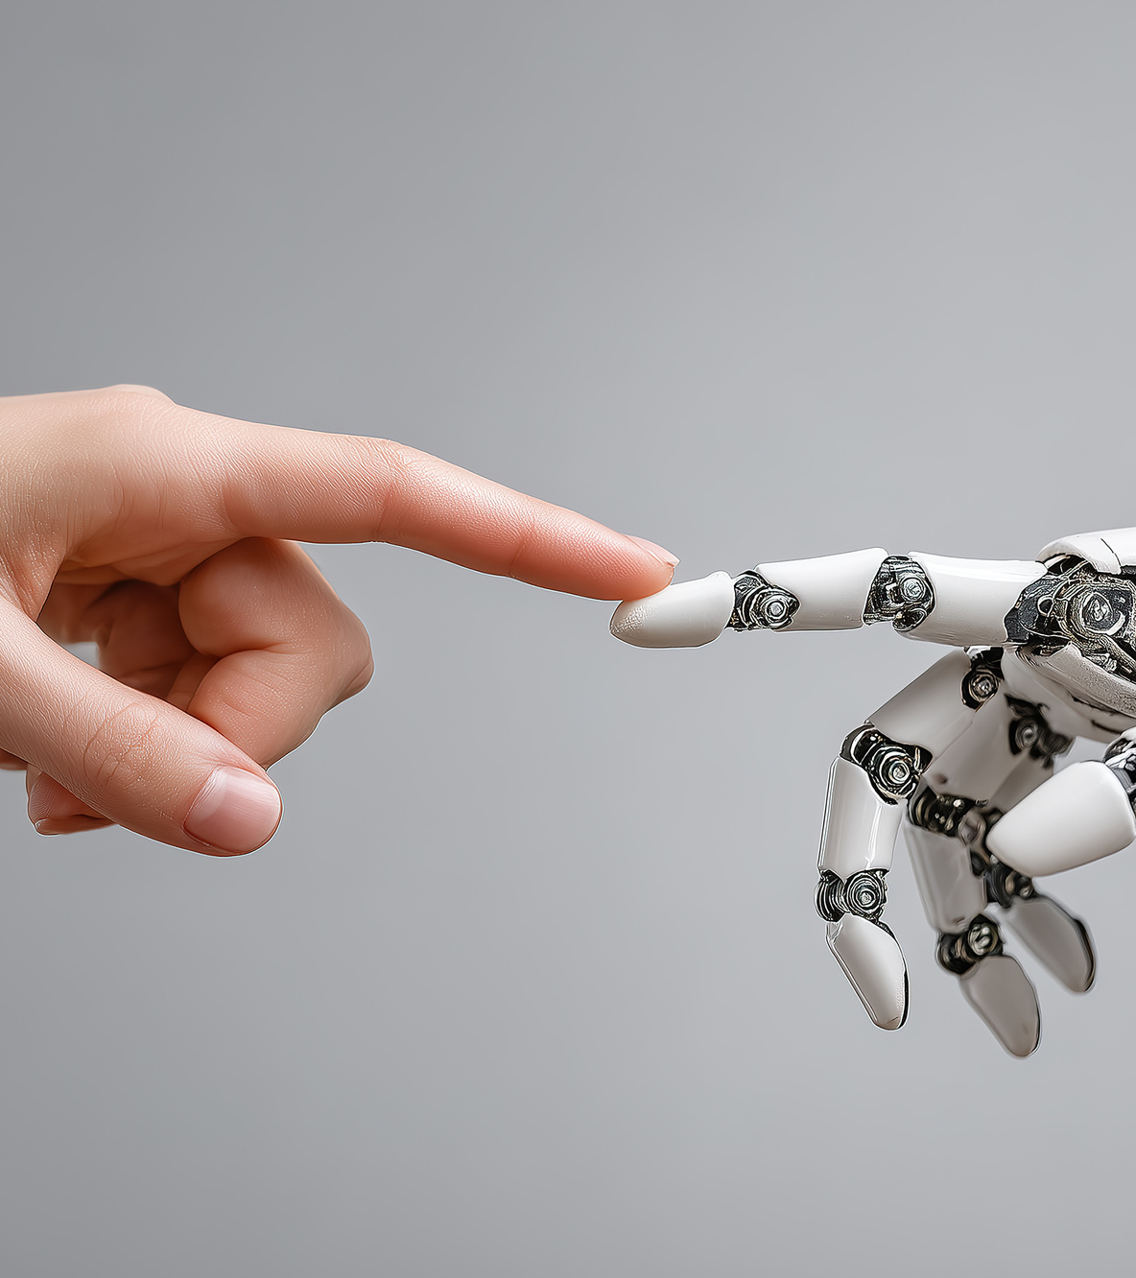
Automation
  Task automations include;
    Auto-assign work based on status
    Auto-set deadlines
    Create follow-up tasks automatically
  Process automation
    Client onboarding checklists
    Quote → job → invoice workflows
    Marketing content pipelines
    Compliance or quality checks
  Off the Shelf AI
    Translation
    Transcription
    Summaries
Notes:
ChatGPT probably created the largets spike in AI interest for the past few years. Before that we had jeopardy champions and AlphaGo. The interest has been mounting since the age of Big Data in the early 00's and has led to development of algorithms and tech capabilities.

Slide 6
Automation
  Tool integrations:
    Email → task creation
    Form submissions → task boards
    Task completion → notifications
  Data flowing automatically into:
    Sales & Marketing tools
    Finance tools
    Reporting dashboards
Automation doesn’t replace people, it removes repetition and uncertainty.
Notes:
ChatGPT probably created the largets spike in AI interest for the past few years. Before that we had jeopardy champions and AlphaGo. The interest has been mounting since the age of Big Data in the early 00's and has led to development of algorithms and tech capabilities.

Slide 7

How To Start
  Start with one core process (e.g. jobs, onboarding, delivery)
  Map it as tasks, not perfection
  Assign ownership clearly
  Let the data accumulate
  Automate only once opportunity/pain is visible
  Structure first. Automate second. Analyse third.
Notes:
ChatGPT probably created the largets spike in AI interest for the past few years. Before that we had jeopardy champions and AlphaGo. The interest has been mounting since the age of Big Data in the early 00's and has led to development of algorithms and tech capabilities.

Slide 8
Intro To Trello

Slide 9
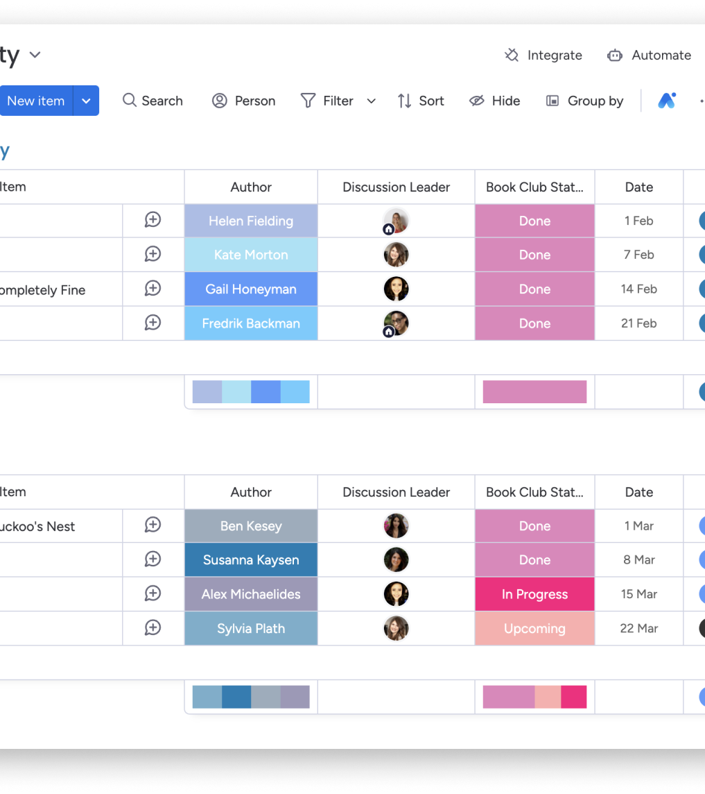
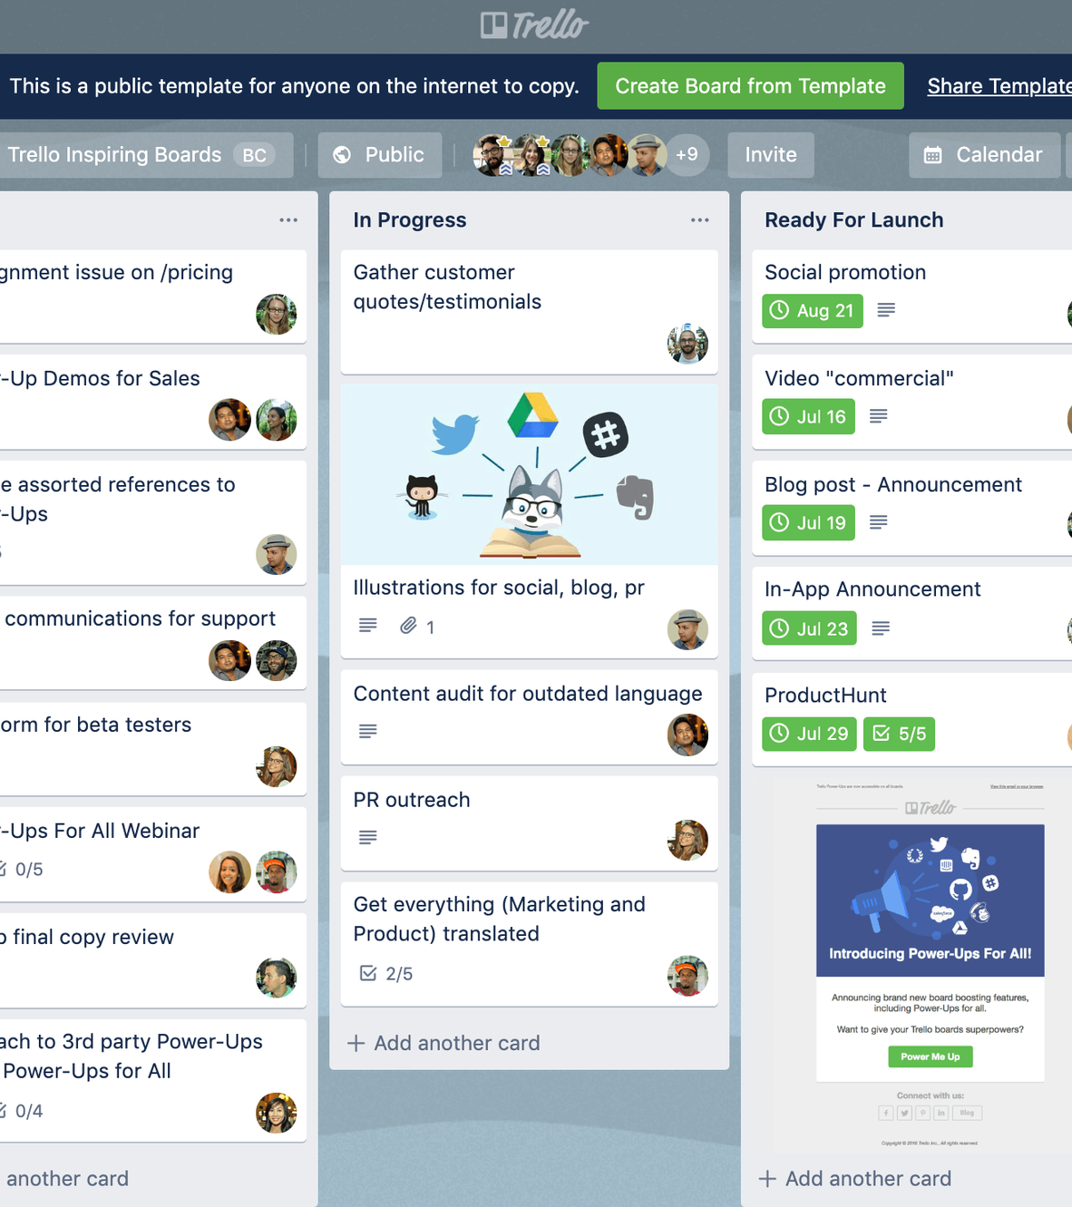
Intro to Trello
Think of Trello as a visual workflow tool, not a to-do list
Best for making work visible at a glance
Each card represents a piece of work moving through a process
Strength comes from:
  clear stages (columns)
  simple ownership
  standard checklists for repeatable work
Generates lightweight data:
  where work gets stuck
  what’s overdue
  who owns what
Notes:
ChatGPT probably created the largets spike in AI interest for the past few years. Before that we had jeopardy champions and AlphaGo. The interest has been mounting since the age of Big Data in the early 00's and has led to development of algorithms and tech capabilities.

Slide 10
Intro to Trello
Automation is about:
  removing follow-ups
  enforcing simple rules
  keeping work moving without chasing
Works best when:
  teams are small
  processes are simple
  adoption matters more than reporting
Trello helps small teams see their work clearly and stop losing tasks in inboxes and conversations.
Notes:
ChatGPT probably created the largets spike in AI interest for the past few years. Before that we had jeopardy champions and AlphaGo. The interest has been mounting since the age of Big Data in the early 00's and has led to development of algorithms and tech capabilities.

Slide 11
Intro To Monday.com

Slide 12
Intro to Monday.com
Think of Monday.com as a structured operations system, not just task management
Similar to a spreadsheet but one that:
  updates in real time
  automates actions
  reports automatically
Strength comes from:
  defined fields (status, owner, priority, dates)
  consistency across the business
  multiple views of the same work
Notes:
ChatGPT probably created the largets spike in AI interest for the past few years. Before that we had jeopardy champions and AlphaGo. The interest has been mounting since the age of Big Data in the early 00's and has led to development of algorithms and tech capabilities.

Slide 13
Intro to Monday.com
Generates richer data:
  workload and capacity
  bottlenecks and delays
  delivery performance
Automation is about:
  enforcing process
  reducing reliance on memory
  creating consistency at scale
Works best when:
  teams are growing
  there are multiple workflows
  management visibility matters.
Notes:
ChatGPT probably created the largets spike in AI interest for the past few years. Before that we had jeopardy champions and AlphaGo. The interest has been mounting since the age of Big Data in the early 00's and has led to development of algorithms and tech capabilities.

Slide 14
Thank You
Any Questions?

