Slide 1


Finance & Accounting Tools (Xero, QuickBooks, FreeAgent)

Slide 2

Why modern finance tools are now a productivity tool
Time is the most expensive resource in a small business
Admin grows faster than revenue
Decisions are only as good as the numbers behind them
Notes:
ChatGPT probably created the largets spike in AI interest for the past few years. Before that we had jeopardy champions and AlphaGo. The interest has been mounting since the age of Big Data in the early 00's and has led to development of algorithms and tech capabilities.

Slide 3

What efficiency actually means in a small business
Efficiency isn’t just working faster, it’s about removing friction
One source of truth
Fewer handovers
Less re-keying
More automation, fewer reminders
Notes:
ChatGPT probably created the largets spike in AI interest for the past few years. Before that we had jeopardy champions and AlphaGo. The interest has been mounting since the age of Big Data in the early 00's and has led to development of algorithms and tech capabilities.

Slide 4

Meet Dales Design & Build Ltd
North Yorkshire–based
12 employees
£700k–£900k annual turnover
Mix of repeat and one-off work
Growing steadily over the last 3 years
Notes:
ChatGPT probably created the largets spike in AI interest for the past few years. Before that we had jeopardy champions and AlphaGo. The interest has been mounting since the age of Big Data in the early 00's and has led to development of algorithms and tech capabilities.

Slide 5

Invoicing for Dales Design & Build
Jobs completed for regular customers
Mix of repeat and one-off work
Owner or admin creating invoices manually
Often rebuilding from the last invoice
Notes:
ChatGPT probably created the largets spike in AI interest for the past few years. Before that we had jeopardy champions and AlphaGo. The interest has been mounting since the age of Big Data in the early 00's and has led to development of algorithms and tech capabilities.

Slide 6
The issue, every invoice starts from scratch
What invoicing looks like today
Typing line items manually
Copying from old invoices
Remembering:
what the client usually buys
agreed prices
any discounts
Risk of spelling mistakes or missing items
Notes:
ChatGPT probably created the largets spike in AI interest for the past few years. Before that we had jeopardy champions and AlphaGo. The interest has been mounting since the age of Big Data in the early 00's and has led to development of algorithms and tech capabilities.

Slide 7
This slows the business down
Invoices take too long to create
Inconsistent descriptions and pricing
Discounts forgotten or applied incorrectly
Customers question invoices
Back-and-forth emails to clarify charges
Notes:
ChatGPT probably created the largets spike in AI interest for the past few years. Before that we had jeopardy champions and AlphaGo. The interest has been mounting since the age of Big Data in the early 00's and has led to development of algorithms and tech capabilities.

Slide 8
The solution, faster invoicing inside finance platforms
Customer records remember:
previous invoices
usual services
pricing and discounts
Saved products & services (price book)
One-click selection of common line items
Quickly add extras from invoice history
Notes:
ChatGPT probably created the largets spike in AI interest for the past few years. Before that we had jeopardy champions and AlphaGo. The interest has been mounting since the age of Big Data in the early 00's and has led to development of algorithms and tech capabilities.

Slide 9
How this works in practice
Creating an invoice becomes:
Select the customer
See what they’ve been billed for before
Add usual line items instantly
Adjust quantities or add extras
Apply known pricing or discounts automatically
Notes:
ChatGPT probably created the largets spike in AI interest for the past few years. Before that we had jeopardy champions and AlphaGo. The interest has been mounting since the age of Big Data in the early 00's and has led to development of algorithms and tech capabilities.

Slide 10
Consistency & accuracy improve automatically
What the system enforces
Consistent wording on invoices
Correct prices every time
Agreed discounts remembered
Fewer spelling or calculation errors
Clear, professional invoices
Notes:
ChatGPT probably created the largets spike in AI interest for the past few years. Before that we had jeopardy champions and AlphaGo. The interest has been mounting since the age of Big Data in the early 00's and has led to development of algorithms and tech capabilities.

Slide 11
The business benefits for Dales Design & Build Ltd
What this changes
Invoices created in minutes, not hours
Fewer customer queries
Less time explaining or correcting invoices
Faster approval and payment
More professional, consistent experience
Good invoicing isn’t faster typing, it’s not typing at all.
Notes:
ChatGPT probably created the largets spike in AI interest for the past few years. Before that we had jeopardy champions and AlphaGo. The interest has been mounting since the age of Big Data in the early 00's and has led to development of algorithms and tech capabilities.

Slide 12
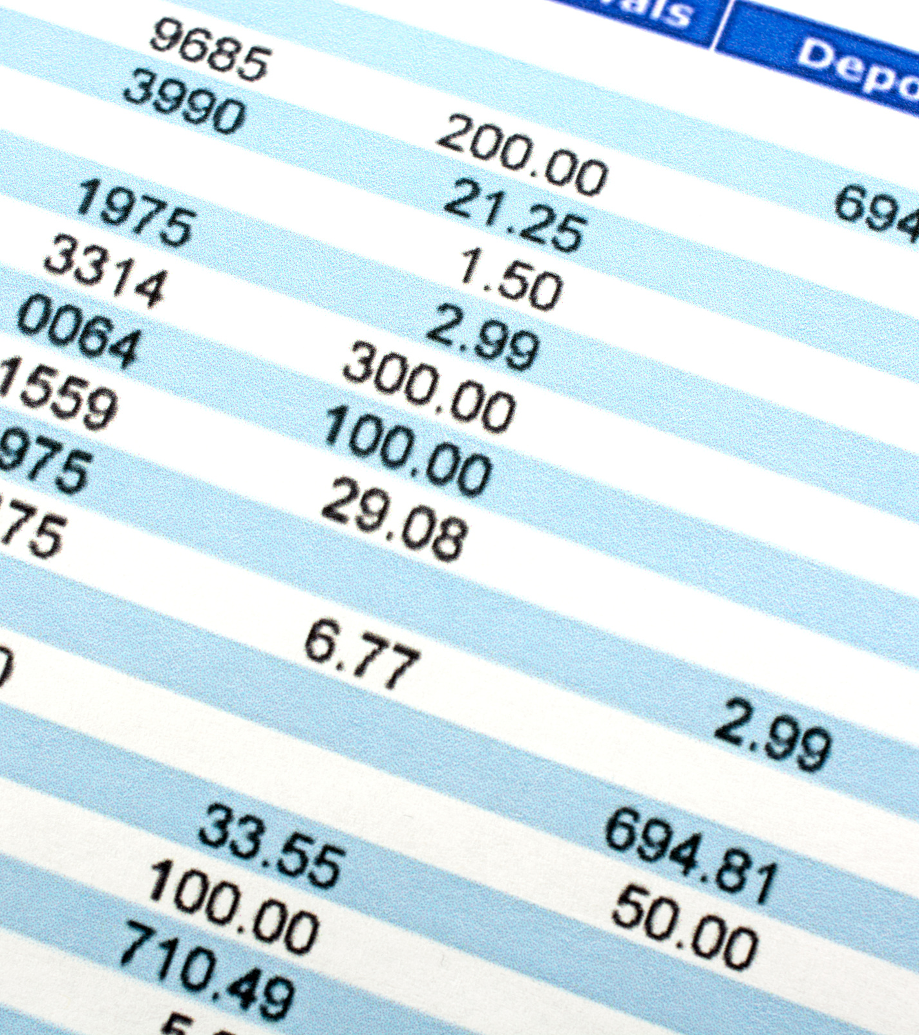
End of the month
End of the month at Dales Design & Build Ltd
Owner logs into online banking
Sees hundreds of transactions
None reflected in the company accounts yet.
Why these transactions need to be captured
Every payment in or out affects:
profit
cash position
tax and VAT
Accounts are built from bank activity
No bank data = no accurate numbers
Notes:
ChatGPT probably created the largets spike in AI interest for the past few years. Before that we had jeopardy champions and AlphaGo. The interest has been mounting since the age of Big Data in the early 00's and has led to development of algorithms and tech capabilities.

Slide 13
Nothing is connected
How this is handled manually
Downloading bank statements
Uploading CSV files
Or typing transactions by hand
Trying to remember what each payment was for
Notes:
ChatGPT probably created the largets spike in AI interest for the past few years. Before that we had jeopardy champions and AlphaGo. The interest has been mounting since the age of Big Data in the early 00's and has led to development of algorithms and tech capabilities.

Slide 14
The problems this creates
Why this becomes painful quickly
Huge backlog builds up
Manual coding takes hours
Mistakes creep in
Month-end takes days, not minutes
Accountant asks follow-up questions
What the business experiences
Reports are always behind reality
Decisions based on old information
Cashflow feels unclear
Finance becomes something to “catch up on”
Notes:
ChatGPT probably created the largets spike in AI interest for the past few years. Before that we had jeopardy champions and AlphaGo. The interest has been mounting since the age of Big Data in the early 00's and has led to development of algorithms and tech capabilities.

Slide 15
Live bank feeds
Let the bank talk to the accounting system
Secure connection to the bank
Transactions flow in automatically
Updated daily
No downloading or uploading
The bank statement comes to you, you don’t go hunting for it.
Notes:
ChatGPT probably created the largets spike in AI interest for the past few years. Before that we had jeopardy champions and AlphaGo. The interest has been mounting since the age of Big Data in the early 00's and has led to development of algorithms and tech capabilities.

Slide 16
Bank reconciliation
Each transaction is:
matched
categorised
confirmed
One-click suggestions based on history
Simple approve-and-move-on process
Notes:
ChatGPT probably created the largets spike in AI interest for the past few years. Before that we had jeopardy champions and AlphaGo. The interest has been mounting since the age of Big Data in the early 00's and has led to development of algorithms and tech capabilities.

Slide 17
How this works in practice
Weekly reconciliation becomes:
Open the bank feed
Review suggested matches
Confirm or adjust
Move on
No spreadsheets. No retyping.
Notes:
ChatGPT probably created the largets spike in AI interest for the past few years. Before that we had jeopardy champions and AlphaGo. The interest has been mounting since the age of Big Data in the early 00's and has led to development of algorithms and tech capabilities.

Slide 18
The business benefits for Dales Design & Build Ltd
The system learns over time
Regular suppliers recognised
Common expenses auto-suggested
Consistent categorisation
Fewer mistakes each month
What changes
No re-keying
Up-to-date numbers at any time
Month-end done faster
Fewer accountant questions
Lower accounting costs
Notes:
ChatGPT probably created the largets spike in AI interest for the past few years. Before that we had jeopardy champions and AlphaGo. The interest has been mounting since the age of Big Data in the early 00's and has led to development of algorithms and tech capabilities.

Slide 19
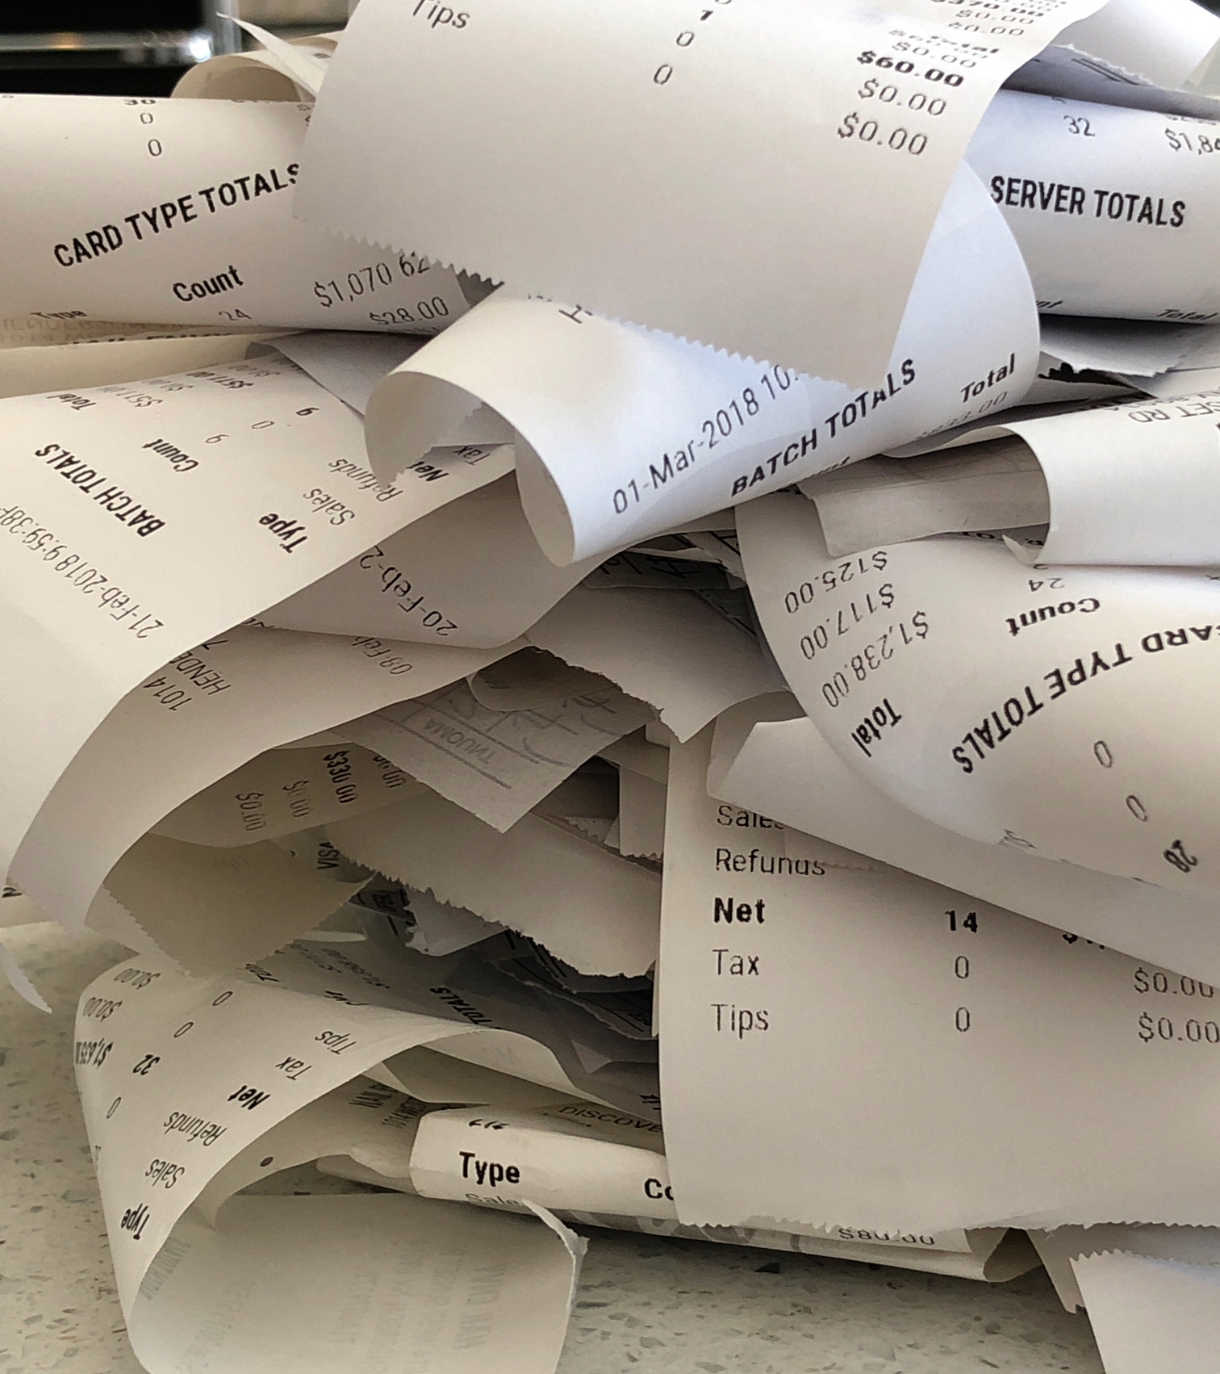
VAT quarter arrives
VAT quarter at Dales Design & Build Ltd
VAT return due
Receipts scattered across:
inboxes
vans
wallets
Some missing
Some unreadable
Notes:
ChatGPT probably created the largets spike in AI interest for the past few years. Before that we had jeopardy champions and AlphaGo. The interest has been mounting since the age of Big Data in the early 00's and has led to development of algorithms and tech capabilities.

Slide 20
Why receipts matter
Why expenses need to be captured properly
HMRC requires evidence for VAT claims
Receipts support:
VAT recovery
expense claims
audits
Notes:
ChatGPT probably created the largets spike in AI interest for the past few years. Before that we had jeopardy champions and AlphaGo. The interest has been mounting since the age of Big Data in the early 00's and has led to development of algorithms and tech capabilities.

Slide 21
The problem, informal expense handling
What’s going wrong
Paper receipts kept “for later”
Photos saved but never uploaded
Emails forwarded inconsistently
Accountant chasing paperwork
Notes:
ChatGPT probably created the largets spike in AI interest for the past few years. Before that we had jeopardy champions and AlphaGo. The interest has been mounting since the age of Big Data in the early 00's and has led to development of algorithms and tech capabilities.

Slide 22
The solution, digital receipt capture
Built into Xero / QuickBooks
Snap receipt on phone
Auto-read supplier, date, amount, VAT
Attach receipt directly to the transaction
Take the photo once, never think about it again.
Notes:
ChatGPT probably created the largets spike in AI interest for the past few years. Before that we had jeopardy champions and AlphaGo. The interest has been mounting since the age of Big Data in the early 00's and has led to development of algorithms and tech capabilities.

Slide 23
What changes for the business
Immediate benefits
Accurate VAT returns
Audit-ready digital records
No end-of-quarter panic
Less time spent looking backwards
If you’ve paid it, capture it once, digitally.
Notes:
ChatGPT probably created the largets spike in AI interest for the past few years. Before that we had jeopardy champions and AlphaGo. The interest has been mounting since the age of Big Data in the early 00's and has led to development of algorithms and tech capabilities.

Slide 24

The VAT bill arrives
VAT return submitted at Dales Design & Build Ltd
VAT return prepared at the deadline
Final number appears for the first time
Higher (or lower) than expected
No time to react
Notes:
ChatGPT probably created the largets spike in AI interest for the past few years. Before that we had jeopardy champions and AlphaGo. The interest has been mounting since the age of Big Data in the early 00's and has led to development of algorithms and tech capabilities.

Slide 25
VAT is often invisible until it’s due
Why this keeps happening
VAT only checked quarterly
No running VAT position
Sales and purchases not reviewed together
VAT money treated like normal cash
Notes:
ChatGPT probably created the largets spike in AI interest for the past few years. Before that we had jeopardy champions and AlphaGo. The interest has been mounting since the age of Big Data in the early 00's and has led to development of algorithms and tech capabilities.

Slide 26
The solution, real time VAT visibility
What Xero / QuickBooks show automatically
Live VAT position at any time
VAT tracked on:
sales invoices
expenses
bank transactions
VAT reports updated daily
Notes:
ChatGPT probably created the largets spike in AI interest for the past few years. Before that we had jeopardy champions and AlphaGo. The interest has been mounting since the age of Big Data in the early 00's and has led to development of algorithms and tech capabilities.

Slide 27
How this changes behaviour
What the business can now do
See VAT building up gradually
Set aside VAT as cash comes in
Spot issues early:
missing receipts
incorrect VAT rates
Avoid last-minute surprises
Notes:
ChatGPT probably created the largets spike in AI interest for the past few years. Before that we had jeopardy champions and AlphaGo. The interest has been mounting since the age of Big Data in the early 00's and has led to development of algorithms and tech capabilities.

Slide 28
The business benefit
What this gives Dales Design & Build Ltd
No VAT shocks
Better cash planning
Fewer errors and corrections
Confidence before the deadline
Notes:
ChatGPT probably created the largets spike in AI interest for the past few years. Before that we had jeopardy champions and AlphaGo. The interest has been mounting since the age of Big Data in the early 00's and has led to development of algorithms and tech capabilities.

Slide 29

At Dales Design & Build Ltd The owner is the finance department
The owner is:
Raising invoices
Chasing payments
Paying suppliers
Answering accountant questions
Notes:
ChatGPT probably created the largets spike in AI interest for the past few years. Before that we had jeopardy champions and AlphaGo. The interest has been mounting since the age of Big Data in the early 00's and has led to development of algorithms and tech capabilities.

Slide 30
Growth hits a ceiling
What this creates
The owner becomes the bottleneck
Decisions wait for one person
Admin grows faster than revenue
No time left for growth or strategy
It’s not about trust, it’s about systems
Finance lives in one person’s head
No clear handover points
Fear of mistakes or loss of control
Everything feels “too risky” to delegate
Notes:
ChatGPT probably created the largets spike in AI interest for the past few years. Before that we had jeopardy champions and AlphaGo. The interest has been mounting since the age of Big Data in the early 00's and has led to development of algorithms and tech capabilities.

Slide 31
The solution: access, permissions & workflows
Built into Xero / QuickBooks
Role-based access:
admin
bookkeeper
accountant
Approvals for:
bills
payments
Accountant access in real time
Control without doing everything yourself.
Notes:
ChatGPT probably created the largets spike in AI interest for the past few years. Before that we had jeopardy champions and AlphaGo. The interest has been mounting since the age of Big Data in the early 00's and has led to development of algorithms and tech capabilities.

Slide 32
How this works in practice
A healthier setup
Admin raises invoices
Owner approves when needed
Accountant reviews live data
No emails, no file sharing
Notes:
ChatGPT probably created the largets spike in AI interest for the past few years. Before that we had jeopardy champions and AlphaGo. The interest has been mounting since the age of Big Data in the early 00's and has led to development of algorithms and tech capabilities.

Slide 33
The business benefit
What this unlocks for Dales Design & Build Ltd
Owner steps out of day-to-day admin
Faster decisions
Fewer interruptions
Business scales sustainably
Notes:
ChatGPT probably created the largets spike in AI interest for the past few years. Before that we had jeopardy champions and AlphaGo. The interest has been mounting since the age of Big Data in the early 00's and has led to development of algorithms and tech capabilities.

Slide 34

Reporting at Dales Design & Build Ltd
Day-to-day work comes first
Reporting done “when things quieten down”
Usually built in spreadsheets
Often skipped altogether
Notes:
ChatGPT probably created the largets spike in AI interest for the past few years. Before that we had jeopardy champions and AlphaGo. The interest has been mounting since the age of Big Data in the early 00's and has led to development of algorithms and tech capabilities.

Slide 35
The problem: manual reporting doesn’t fit reality
Why reporting never happens properly
Data spread across systems
Figures copied manually
Reports take hours or days to build
High risk of mistakes and inconsistencies
Notes:
ChatGPT probably created the largets spike in AI interest for the past few years. Before that we had jeopardy champions and AlphaGo. The interest has been mounting since the age of Big Data in the early 00's and has led to development of algorithms and tech capabilities.

Slide 36
The real issue, out of date information
Why this hurts decision-making
Reports describe the past
Numbers are weeks old
Decisions made reactively
Problems spotted too late
Notes:
ChatGPT probably created the largets spike in AI interest for the past few years. Before that we had jeopardy champions and AlphaGo. The interest has been mounting since the age of Big Data in the early 00's and has led to development of algorithms and tech capabilities.

Slide 37
The knock on effect on the business
What this causes
Cash issues spotted late
Low-margin work continues
Pricing decisions based on gut feel
No clear view of performance
Notes:
ChatGPT probably created the largets spike in AI interest for the past few years. Before that we had jeopardy champions and AlphaGo. The interest has been mounting since the age of Big Data in the early 00's and has led to development of algorithms and tech capabilities.

Slide 38
Automated reporting built into the platforms
What Xero / QuickBooks provide
Live profit & loss
Balance sheet and cash position
VAT and tax reports
Consistent, standardised reporting
Notes:
ChatGPT probably created the largets spike in AI interest for the past few years. Before that we had jeopardy champions and AlphaGo. The interest has been mounting since the age of Big Data in the early 00's and has led to development of algorithms and tech capabilities.

Slide 39
Reporting at Dales Design & Build Ltd
Day-to-day work comes first
Reporting done “when things quieten down”
Usually built in spreadsheets
Often skipped altogether
Notes:
ChatGPT probably created the largets spike in AI interest for the past few years. Before that we had jeopardy champions and AlphaGo. The interest has been mounting since the age of Big Data in the early 00's and has led to development of algorithms and tech capabilities.

Slide 40
Reporting at Dales Design & Build Ltd
Day-to-day work comes first
Reporting done “when things quieten down”
Usually built in spreadsheets
Often skipped altogether
Notes:
ChatGPT probably created the largets spike in AI interest for the past few years. Before that we had jeopardy champions and AlphaGo. The interest has been mounting since the age of Big Data in the early 00's and has led to development of algorithms and tech capabilities.

Slide 41

In Summary
Modern finance tools like Xero & QuickBooks help you:
Generate invoices faster and more consistently
Get paid sooner with fewer questions
Automatically import and categorise bank transactions
Capture receipts once and never lose them
Track VAT in real time and avoid surprises
Delegate finance tasks safely without losing control
See accurate financial performance at any time
Notes:
ChatGPT probably created the largets spike in AI interest for the past few years. Before that we had jeopardy champions and AlphaGo. The interest has been mounting since the age of Big Data in the early 00's and has led to development of algorithms and tech capabilities.

Slide 42
In Summary
Meaning:
Less manual admin, fewer spreadsheets
More time back each week
Fewer errors and corrections
Better visibility of cash, VAT, and profit
Faster, more confident decision-making
A business that scales without the owner becoming the bottleneck
Notes:
ChatGPT probably created the largets spike in AI interest for the past few years. Before that we had jeopardy champions and AlphaGo. The interest has been mounting since the age of Big Data in the early 00's and has led to development of algorithms and tech capabilities.

Slide 43
Live Demo

Slide 44
Thank You
Any Questions?

