Slide 1


CRM Tools for SMEs (HubSpot, Pipedrive, Zoho)

Slide 2

The Reality for Small Businesses
Enquiries come in… but follow-up is inconsistent
Sales lives in inboxes, phones, notebooks, and memory
No clear way to see what’s “in progress” vs “gone cold”
You’re busy delivering work, not chasing leads.
Past mistakes often repeated.
Notes:
ChatGPT probably created the largets spike in AI interest for the past few years. Before that we had jeopardy champions and AlphaGo. The interest has been mounting since the age of Big Data in the early 00's and has led to development of algorithms and tech capabilities.

Slide 3
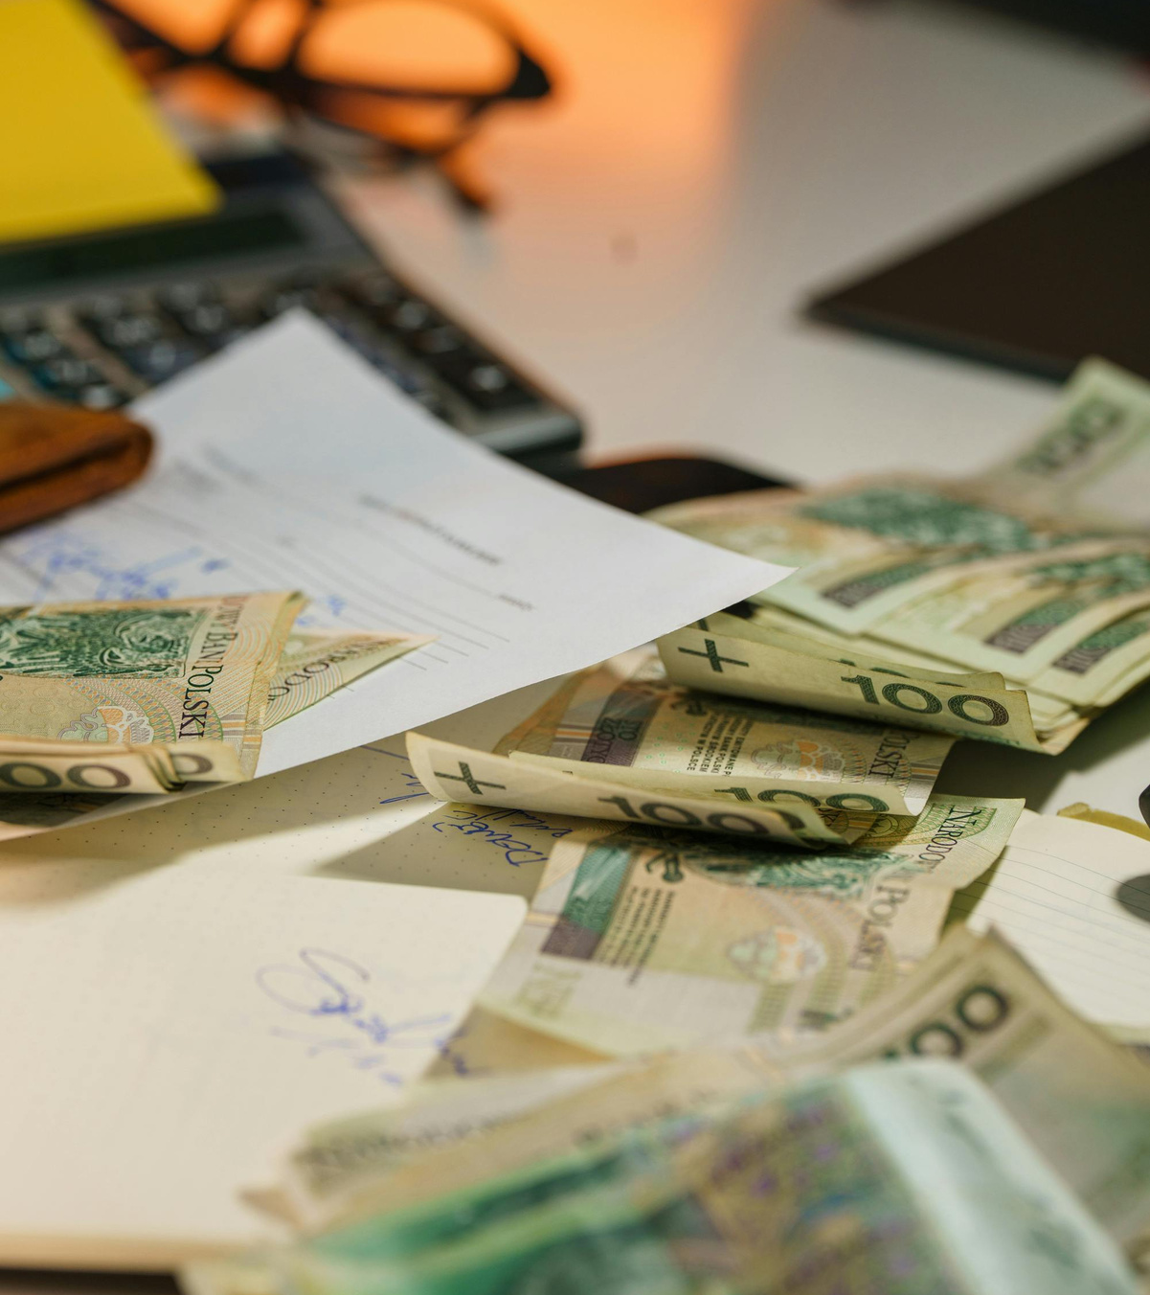
When sales is messy, cashflow becomes fragile
Missed follow ups = missed revenue
Unpredictable sales = unpredictable cashflow
Cashflow pressure affects confidence and decisions
Long gaps between jobs put survival at risk
Missed opportunities for upselling and cross selling
Cyclical sales process, sell - deliver - sell - deliver
A lot of small businesses fail because income is inconsistent.
Notes:
ChatGPT probably created the largets spike in AI interest for the past few years. Before that we had jeopardy champions and AlphaGo. The interest has been mounting since the age of Big Data in the early 00's and has led to development of algorithms and tech capabilities.

Slide 4

Common Sales Pain Points
“I meant to get back to them…”
“I know we spoke before, but I can’t remember when”
“We’re getting enquiries, but not enough convert”
“Some customers take loads of time and never buy”
“I struggle to balance selling and delivering to customers.”
Notes:
ChatGPT probably created the largets spike in AI interest for the past few years. Before that we had jeopardy champions and AlphaGo. The interest has been mounting since the age of Big Data in the early 00's and has led to development of algorithms and tech capabilities.

Slide 5

The Cost of Disorganisation
Slow responses lose warm leads
Time wasted on poor fit prospects
No visibility on what’s actually working
Growth feels risky instead of controlled
When you need sales the most, you start the sales processes again
Notes:
ChatGPT probably created the largets spike in AI interest for the past few years. Before that we had jeopardy champions and AlphaGo. The interest has been mounting since the age of Big Data in the early 00's and has led to development of algorithms and tech capabilities.

Slide 6
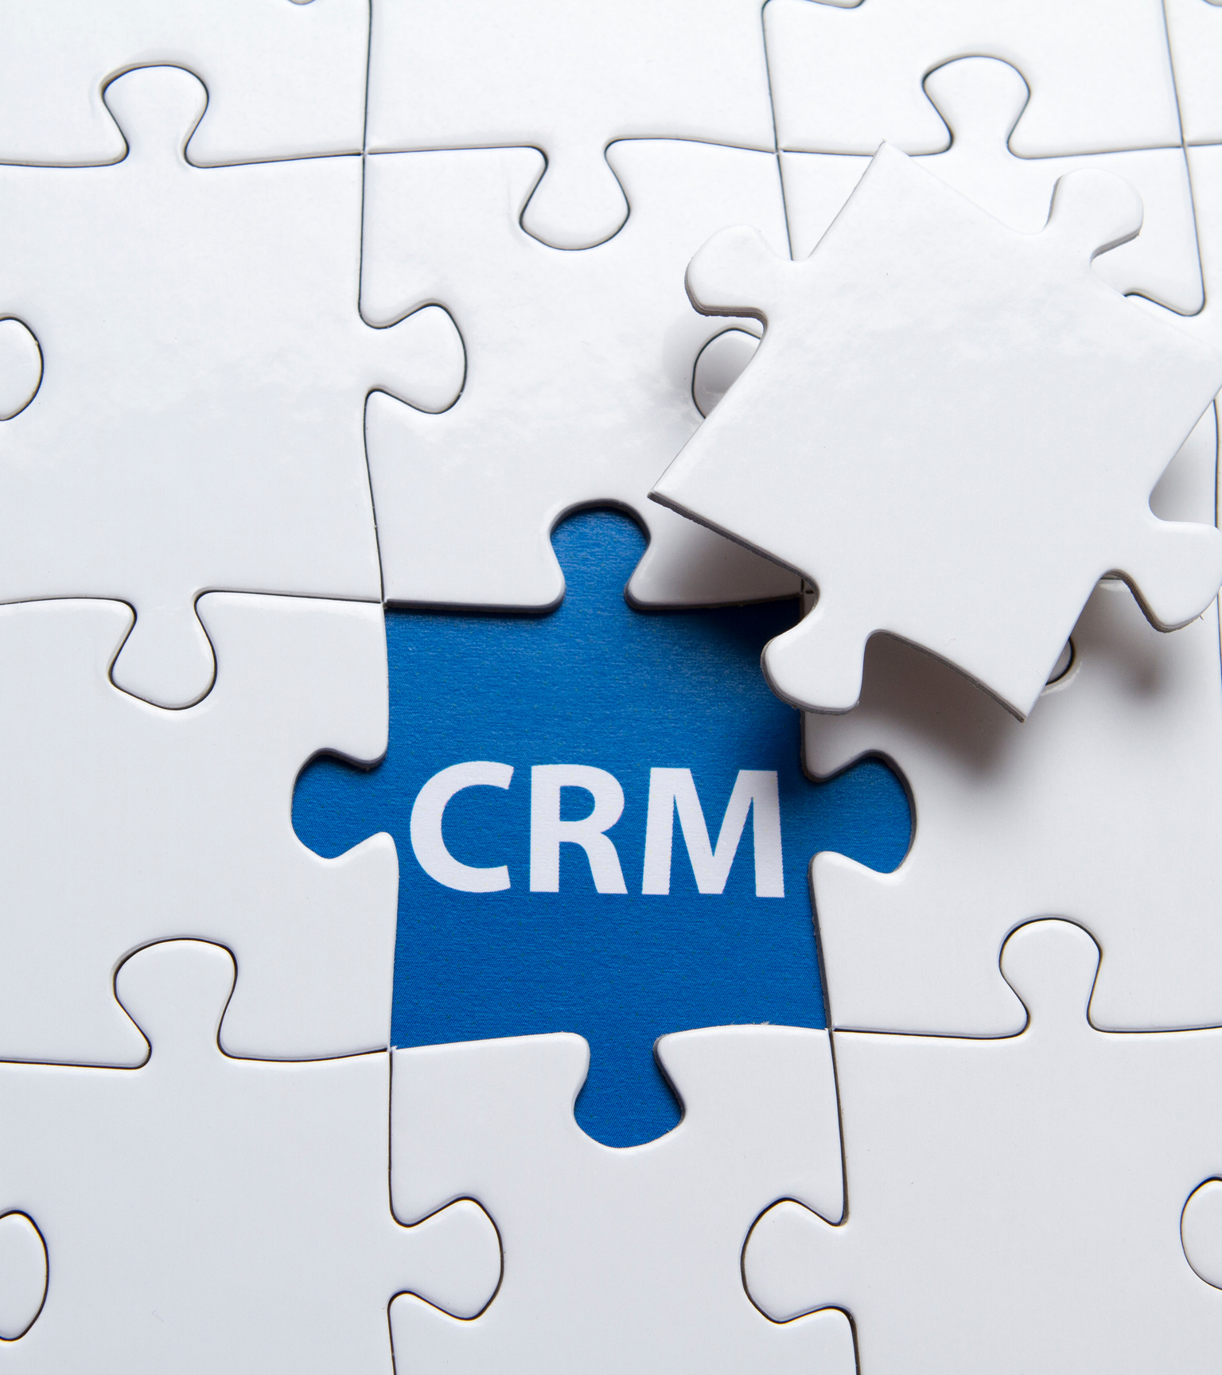
So… What Is a CRM?
A CRM is a...
customer relationship management tool.
place to track all enquiries and customers
shared memory for your business
system that reminds you to follow up
way to turn interest into income
Notes:
ChatGPT probably created the largets spike in AI interest for the past few years. Before that we had jeopardy champions and AlphaGo. The interest has been mounting since the age of Big Data in the early 00's and has led to development of algorithms and tech capabilities.

Slide 7

What CRMs Are Used For
Capturing enquiries automatically
Tracking conversations and follow ups
Seeing who’s likely to buy and who isn’t
Managing deals from “new lead” to “paid”
Automating sales tasks to enhance sales processes
Tools like Pipedrive and HubSpot are built specifically for this.
Notes:
ChatGPT probably created the largets spike in AI interest for the past few years. Before that we had jeopardy champions and AlphaGo. The interest has been mounting since the age of Big Data in the early 00's and has led to development of algorithms and tech capabilities.

Slide 8

Scenario: Slow Follow-Up
The fastest reply usually wins
A customer enquires on Monday
You reply Thursday, they’ve already decided
Not because you’re worse, but because you were slower
CRM impact:
Automatic reminders
Clear “next action”
No leads forgotten
Notes:
ChatGPT probably created the largets spike in AI interest for the past few years. Before that we had jeopardy champions and AlphaGo. The interest has been mounting since the age of Big Data in the early 00's and has led to development of algorithms and tech capabilities.

Slide 9

Scenario: Time Wasters
Not all leads are equal
Some prospects drain time
Endless questions, no commitment
Others are ready but get delayed
CRM impact:
See enquiry history at a glance
Spot patterns in who converts
Focus energy where it matters
Enrich insight to help influence your decisions.
Notes:
ChatGPT probably created the largets spike in AI interest for the past few years. Before that we had jeopardy champions and AlphaGo. The interest has been mounting since the age of Big Data in the early 00's and has led to development of algorithms and tech capabilities.

Slide 10

Increasing Reach
Doing more with the people already interested
Capture leads from your website, emails, and social media
Automatically send simple follow-ups and thank-you emails
Keep your business visible without constant manual chasing
Reuse messages that already work instead of starting from scratch
What this means in reality:
More touchpoints, less effort
Staying front of mind without being pushy
No need for big marketing budgets or agencies
It’s not about spamming people it’s about staying in the conversation.
Notes:
ChatGPT probably created the largets spike in AI interest for the past few years. Before that we had jeopardy champions and AlphaGo. The interest has been mounting since the age of Big Data in the early 00's and has led to development of algorithms and tech capabilities.

Slide 11

Personalising the Conversation
People buy when it feels relevant
Remember what they asked for
Reference past conversations
Tailor follow ups to their needs
CRM impact:
Context before every call
Notes visible to the whole team
Customers feel listened to
Personalised sales and marketing emails
Notes:
ChatGPT probably created the largets spike in AI interest for the past few years. Before that we had jeopardy champions and AlphaGo. The interest has been mounting since the age of Big Data in the early 00's and has led to development of algorithms and tech capabilities.

Slide 12

Improving Conversion Rates
Small improvements compound
See where deals get stuck
Learn which follow ups work best
Compare results over time
Without a CRM: guessing
With a CRM: evidence
Notes:
ChatGPT probably created the largets spike in AI interest for the past few years. Before that we had jeopardy champions and AlphaGo. The interest has been mounting since the age of Big Data in the early 00's and has led to development of algorithms and tech capabilities.

Slide 13

Knowing What’s Working (and What Isn’t)
Confidence replaces uncertainty
Are quicker replies improving sales?
Are certain services converting better?
Is your new sales approach paying off?
CRMs turn opinions into insight.
Notes:
ChatGPT probably created the largets spike in AI interest for the past few years. Before that we had jeopardy champions and AlphaGo. The interest has been mounting since the age of Big Data in the early 00's and has led to development of algorithms and tech capabilities.

Slide 14

Why This Matters
Less stress. More control. Better growth.
Predictable sales pipeline
More stable cashflow
Better decisions
A business that scales without chaos
Notes:
ChatGPT probably created the largets spike in AI interest for the past few years. Before that we had jeopardy champions and AlphaGo. The interest has been mounting since the age of Big Data in the early 00's and has led to development of algorithms and tech capabilities.

Slide 15
Live Demo

Slide 16
Thank You
Any Questions?

