Slide 1


Business Productivity Suites (MS365, Google Workspace)

Slide 2

Why this session matters
Productivity tools are no longer “office software”.
They are the day to day operating system of your business.
Every email sent, file saved, task assigned, approval given, or report created flows through these tools.
Notes:
ChatGPT probably created the largets spike in AI interest for the past few years. Before that we had jeopardy champions and AlphaGo. The interest has been mounting since the age of Big Data in the early 00's and has led to development of algorithms and tech capabilities.

Slide 3
Why this session matters
Within these tools is where businesses quietly lose time every week.
Manual admin and repetitive tasks.
Searching for the right version of a document.
Re-entering the same information in multiple places
Chasing emails, approvals, and updates
These are small, repeated inefficiencies.
Notes:
ChatGPT probably created the largets spike in AI interest for the past few years. Before that we had jeopardy champions and AlphaGo. The interest has been mounting since the age of Big Data in the early 00's and has led to development of algorithms and tech capabilities.

Slide 4
Cheap or inconsistent tools cost more over time
Different tools used by different people
Files that don’t open properly
Access issues
Workarounds instead of workflows
Shared accounts
Each issue seems minor but small frictions repeated daily add up to real cost.
Notes:
ChatGPT probably created the largets spike in AI interest for the past few years. Before that we had jeopardy champions and AlphaGo. The interest has been mounting since the age of Big Data in the early 00's and has led to development of algorithms and tech capabilities.

Slide 5
Cheap or inconsistent tools cost more over time
What modern productivity suites actually do
Automate routine work
Keep everyone working in the same way
Reduce duplication and errors
Enable secure, flexible working
The goal...
Less time on admin.
More time on customers, delivery and growth.
Notes:
ChatGPT probably created the largets spike in AI interest for the past few years. Before that we had jeopardy champions and AlphaGo. The interest has been mounting since the age of Big Data in the early 00's and has led to development of algorithms and tech capabilities.

Slide 6

What Is a Productivity Suite?
A connected set of tools for:
Documents
Email & calendars
File storage
Communication
Collaboration
Automation
Security
Two main players:
Microsoft 365
Google Workspace
Notes:
ChatGPT probably created the largets spike in AI interest for the past few years. Before that we had jeopardy champions and AlphaGo. The interest has been mounting since the age of Big Data in the early 00's and has led to development of algorithms and tech capabilities.

Slide 7
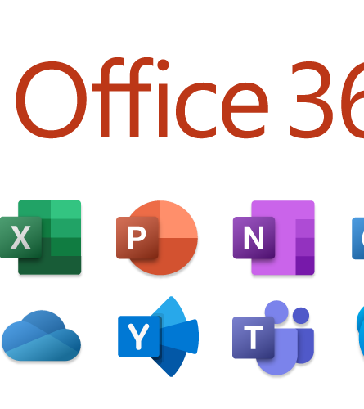
Microsoft 365 Core Apps (The Basics)
Word – Documents, contracts, policies
Excel – Data, calculations, reporting, lists
PowerPoint – Presentations, sales decks, training
Outlook – Email, calendars, contacts, task management
Notes:
ChatGPT probably created the largets spike in AI interest for the past few years. Before that we had jeopardy champions and AlphaGo. The interest has been mounting since the age of Big Data in the early 00's and has led to development of algorithms and tech capabilities.

Slide 8

File Storage
OneDrive
Personal working files
Accessible anywhere
Automatically backed up
Ideal for drafts and individual work
SharePoint
Team and business documents
Shared access
Clear permissions
One agreed place for important files
Why cloud storage wins
Files aren’t tied to a device
Access controlled centrally
No panic when a laptop breaks or someone leaves
Work follows the business, not the hardware.
Notes:
ChatGPT probably created the largets spike in AI interest for the past few years. Before that we had jeopardy champions and AlphaGo. The interest has been mounting since the age of Big Data in the early 00's and has led to development of algorithms and tech capabilities.

Slide 9
Version Control: One Source of Truth
Version control
Every change is tracked
Older versions can be restored
No more emailing attachments back and forth
What this means in practice
Everyone works from the same document
Fewer errors
Clear accountability
No “which version is correct?” conversations
Notes:
ChatGPT probably created the largets spike in AI interest for the past few years. Before that we had jeopardy champions and AlphaGo. The interest has been mounting since the age of Big Data in the early 00's and has led to development of algorithms and tech capabilities.

Slide 10
Working Together, At the Same Time
Real-time collaboration
Multiple people can open the same document
Changes appear instantly
Comments and suggestions in context
Why this matters
Faster turnaround
Less emailing
Fewer meetings just to “sync up”
Collaboration should happen inside the work, not around it.
Notes:
ChatGPT probably created the largets spike in AI interest for the past few years. Before that we had jeopardy champions and AlphaGo. The interest has been mounting since the age of Big Data in the early 00's and has led to development of algorithms and tech capabilities.

Slide 11
Automatic Saving: No More Lost Work
A small feature with a big impact
Every keystroke is saved automatically
No “Did you save?” moments
No lost work due to crashes or power cuts
Why businesses underestimate this
Lost work isn’t visible on invoices
But it costs time, morale, and momentum
Notes:
ChatGPT probably created the largets spike in AI interest for the past few years. Before that we had jeopardy champions and AlphaGo. The interest has been mounting since the age of Big Data in the early 00's and has led to development of algorithms and tech capabilities.

Slide 12

Communication
What Microsoft Teams provides
Chat, video calls, and online meetings in one place
Conversations linked directly to files, calendars, and tasks
Channels for teams, projects, or departments
A shared, searchable record of decisions and discussions
Notes:
ChatGPT probably created the largets spike in AI interest for the past few years. Before that we had jeopardy champions and AlphaGo. The interest has been mounting since the age of Big Data in the early 00's and has led to development of algorithms and tech capabilities.

Slide 13
Communication
Call recording for future reference
Meetings and calls can be recorded
Recordings are stored securely in the cloud
Easy to revisit key discussions
Business benefit:
No reliance on memory
Less “I don’t remember that being agreed”
Useful for training, handovers, and compliance
Notes:
ChatGPT probably created the largets spike in AI interest for the past few years. Before that we had jeopardy champions and AlphaGo. The interest has been mounting since the age of Big Data in the early 00's and has led to development of algorithms and tech capabilities.

Slide 14
Communication
Automatic call transcription
Conversations are converted into searchable text
Quickly find:
Decisions
Action points
Names, dates, and figures
Efficiency gain:
No need for manual note-taking
Faster follow-ups
Clearer accountability
With recordings and transcripts, AI can:
summarise meetings
Highlight actions
Extract key points automatically
Notes:
ChatGPT probably created the largets spike in AI interest for the past few years. Before that we had jeopardy champions and AlphaGo. The interest has been mounting since the age of Big Data in the early 00's and has led to development of algorithms and tech capabilities.

Slide 15
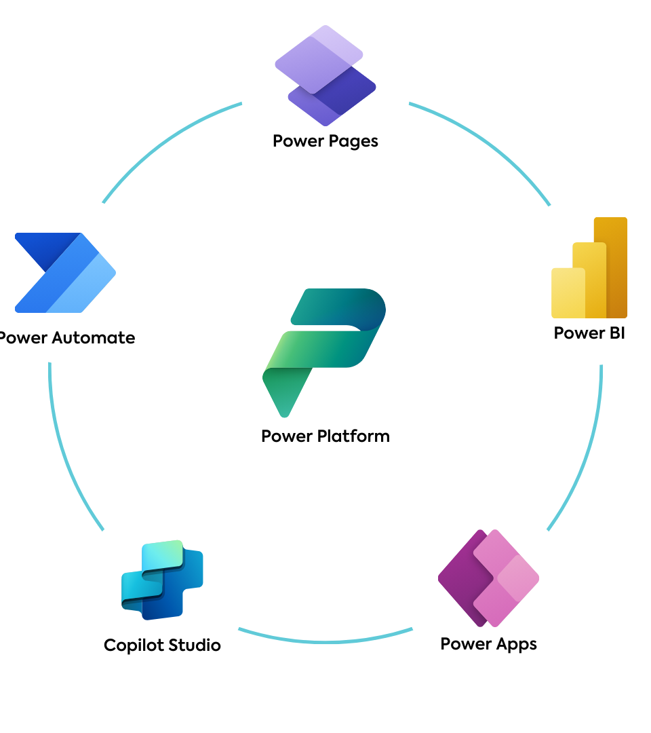
The Power Platform
The Power Platform turns Microsoft 365 into a productivity engine
Includes:
Power Automate
Power Apps
Power BI
Power Virtual Agents (Copilot Studio)
This is where time-saving automation really happens.
Notes:
ChatGPT probably created the largets spike in AI interest for the past few years. Before that we had jeopardy champions and AlphaGo. The interest has been mounting since the age of Big Data in the early 00's and has led to development of algorithms and tech capabilities.

Slide 16
PowerBI
Power BI turns raw data into:
Dashboards
Reports
Clear, visual insights
It connects to:
Excel
Accounting systems
CRMs
Operational systems
Why this matters for productivity
Less time building reports
Less manual number crunching
Everyone looks at the same figures
Notes:
ChatGPT probably created the largets spike in AI interest for the past few years. Before that we had jeopardy champions and AlphaGo. The interest has been mounting since the age of Big Data in the early 00's and has led to development of algorithms and tech capabilities.

Slide 17
Power Apps
Power Apps allows you to create simple business apps:
Forms
Checklists
Data entry tools
Internal systems
All without building software from scratch.
Common business examples:
Job tracking
Site inspections
Asset registers
Customer request forms
Internal approval forms
Notes:
ChatGPT probably created the largets spike in AI interest for the past few years. Before that we had jeopardy champions and AlphaGo. The interest has been mounting since the age of Big Data in the early 00's and has led to development of algorithms and tech capabilities.

Slide 18
Power Apps
Why this boosts efficiency
Removes paper and email chains
Reduces errors from manual entry
Standardises how data is captured
If a process relies on emails and spreadsheets, it’s a candidate for a Power App.
Notes:
ChatGPT probably created the largets spike in AI interest for the past few years. Before that we had jeopardy champions and AlphaGo. The interest has been mounting since the age of Big Data in the early 00's and has led to development of algorithms and tech capabilities.

Slide 19
Power Automate
Power Automate connects systems and actions together to:
Trigger workflows
Move data automatically
Send notifications
Handle approvals
Everyday examples
Save email attachments automatically
Notify someone when a form is submitted
Route invoices for approval
Update multiple systems at once
Notes:
ChatGPT probably created the largets spike in AI interest for the past few years. Before that we had jeopardy champions and AlphaGo. The interest has been mounting since the age of Big Data in the early 00's and has led to development of algorithms and tech capabilities.

Slide 20
Power Automate
Productivity impact
Less copying and pasting
Fewer missed steps
Faster turnaround
Notes:
ChatGPT probably created the largets spike in AI interest for the past few years. Before that we had jeopardy champions and AlphaGo. The interest has been mounting since the age of Big Data in the early 00's and has led to development of algorithms and tech capabilities.

Slide 21
Copilot Studio
Copilot Studio allows businesses to build AI assistants that:
Answer questions
Guide users through processes
Work from company-approved information
AI grounded in your business.
Practical use cases
Internal “how do I?” support
HR and policy queries
IT and admin help
Customer-facing FAQs
Notes:
ChatGPT probably created the largets spike in AI interest for the past few years. Before that we had jeopardy champions and AlphaGo. The interest has been mounting since the age of Big Data in the early 00's and has led to development of algorithms and tech capabilities.

Slide 22
Copilot Studio
Why this matters for efficiency
Reduces interruptions
Frees up experienced staff
Gives instant answers, 24/7
AI becomes useful when it knows your rules, your data and your processes.
Notes:
ChatGPT probably created the largets spike in AI interest for the past few years. Before that we had jeopardy champions and AlphaGo. The interest has been mounting since the age of Big Data in the early 00's and has led to development of algorithms and tech capabilities.

Slide 23
Power Platform Example
A business manages jobs or internal requests using:
Emails
Spreadsheets
Phone calls
Paper notes
Typical issues:
Requests get missed
No clear status
Managers chase updates
Reporting is manual and delayed
Notes:
ChatGPT probably created the largets spike in AI interest for the past few years. Before that we had jeopardy champions and AlphaGo. The interest has been mounting since the age of Big Data in the early 00's and has led to development of algorithms and tech capabilities.

Slide 24
Power Platform Example
Step 1: Power Apps – Capture the Request
A simple app replaces emails and paper forms
Staff submit:
Job requests
Maintenance issues
Customer requests
Required fields ensure consistent information
Productivity win:
No back-and-forth asking for missing details.
Notes:
ChatGPT probably created the largets spike in AI interest for the past few years. Before that we had jeopardy champions and AlphaGo. The interest has been mounting since the age of Big Data in the early 00's and has led to development of algorithms and tech capabilities.

Slide 25
Power Platform Example
Step 2: Power Automate – Move the Work Along
Submission triggers an automated workflow:
Notifies the right person
Creates tasks
Requests approval if needed
Status updates happen automatically
Efficiency win:
No manual chasing, fewer bottlenecks.
Notes:
ChatGPT probably created the largets spike in AI interest for the past few years. Before that we had jeopardy champions and AlphaGo. The interest has been mounting since the age of Big Data in the early 00's and has led to development of algorithms and tech capabilities.

Slide 26
Power Platform Example
Step 3: SharePoint / Dataverse – One Source of Truth
All requests stored centrally
Clear ownership and status
Access controlled by role
Business win:
Nothing lives “in someone’s inbox”.
Notes:
ChatGPT probably created the largets spike in AI interest for the past few years. Before that we had jeopardy champions and AlphaGo. The interest has been mounting since the age of Big Data in the early 00's and has led to development of algorithms and tech capabilities.

Slide 27
Power Platform Example
Step 4: Power BI – Visibility & Insight
Live dashboard shows:
Open jobs
Completion times
Bottlenecks
Managers see problems early
Productivity win:
Decisions based on facts, not guesswork.
Notes:
ChatGPT probably created the largets spike in AI interest for the past few years. Before that we had jeopardy champions and AlphaGo. The interest has been mounting since the age of Big Data in the early 00's and has led to development of algorithms and tech capabilities.

Slide 28
Power Platform Example
Step 5: Copilot Studio – AI Support Layer
Staff can ask:
“What jobs are overdue?”
“How do I submit a request?”
“What’s the status of my job?”
AI responds using approved business data
Efficiency win:
Fewer interruptions, faster answers.
Notes:
ChatGPT probably created the largets spike in AI interest for the past few years. Before that we had jeopardy champions and AlphaGo. The interest has been mounting since the age of Big Data in the early 00's and has led to development of algorithms and tech capabilities.

Slide 29
Power Platform Impact
Before
Emails and spreadsheets
Manual updates
No real-time visibility
Knowledge in people’s heads
After
Structured input
Automated workflows
Live reporting
AI-assisted access to information
What actually improves
Faster turnaround
Fewer errors
Less frustration
Better accountability
Easier scaling as the business grows
Notes:
ChatGPT probably created the largets spike in AI interest for the past few years. Before that we had jeopardy champions and AlphaGo. The interest has been mounting since the age of Big Data in the early 00's and has led to development of algorithms and tech capabilities.

Slide 30

Cautionary Tale
Important warning:
GoDaddy, IONOS, etc. sell restricted Microsoft accounts
Limited admin access
Difficult migrations
Reduced automation capability
Recommendation:
Buy Microsoft 365 directly from Microsoft or a proper Microsoft Partner
Short-term convenience often creates long-term productivity problems.
Notes:
ChatGPT probably created the largets spike in AI interest for the past few years. Before that we had jeopardy champions and AlphaGo. The interest has been mounting since the age of Big Data in the early 00's and has led to development of algorithms and tech capabilities.

Slide 31
Pricing

Slide 32
Live MS365 Walkthrough

Slide 33
Thank You
Any Questions?

