Slide 1


Data Analytics Webinar: Data Visualisation

Slide 2














MANAGING THE DATA LIFECYCLE
Clean
Analyse
Generate & Capture
Store
Present & Consume
Notes:
Where are we currently with AI? And why am I asking you to forget about it?

Slide 3

Why Visualisation Matters
Humans are not designed to interpret large tables of numbers, visualisation transforms complexity into insight.
Notes:
ChatGPT probably created the largets spike in AI interest for the past few years. Before that we had jeopardy champions and AlphaGo. The interest has been mounting since the age of Big Data in the early 00's and has led to development of algorithms and tech capabilities.

Slide 4
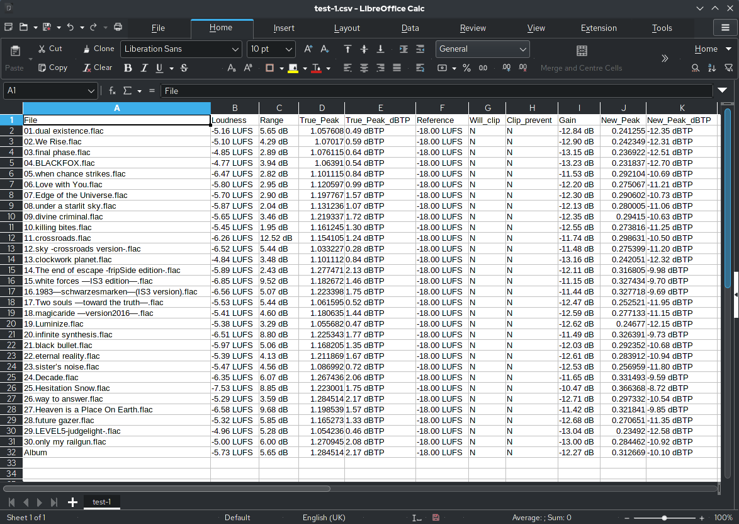

Slide 5
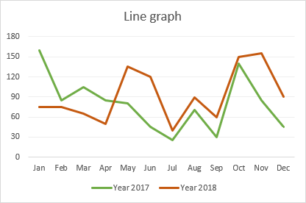

Slide 6



Microsoft PowerBI
The Big 3
Tableau
Qlik
Notes:
ChatGPT probably created the largets spike in AI interest for the past few years. Before that we had jeopardy champions and AlphaGo. The interest has been mounting since the age of Big Data in the early 00's and has led to development of algorithms and tech capabilities.

Slide 7
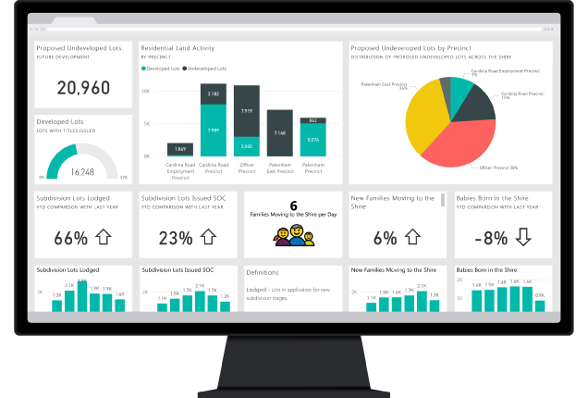

Slide 8
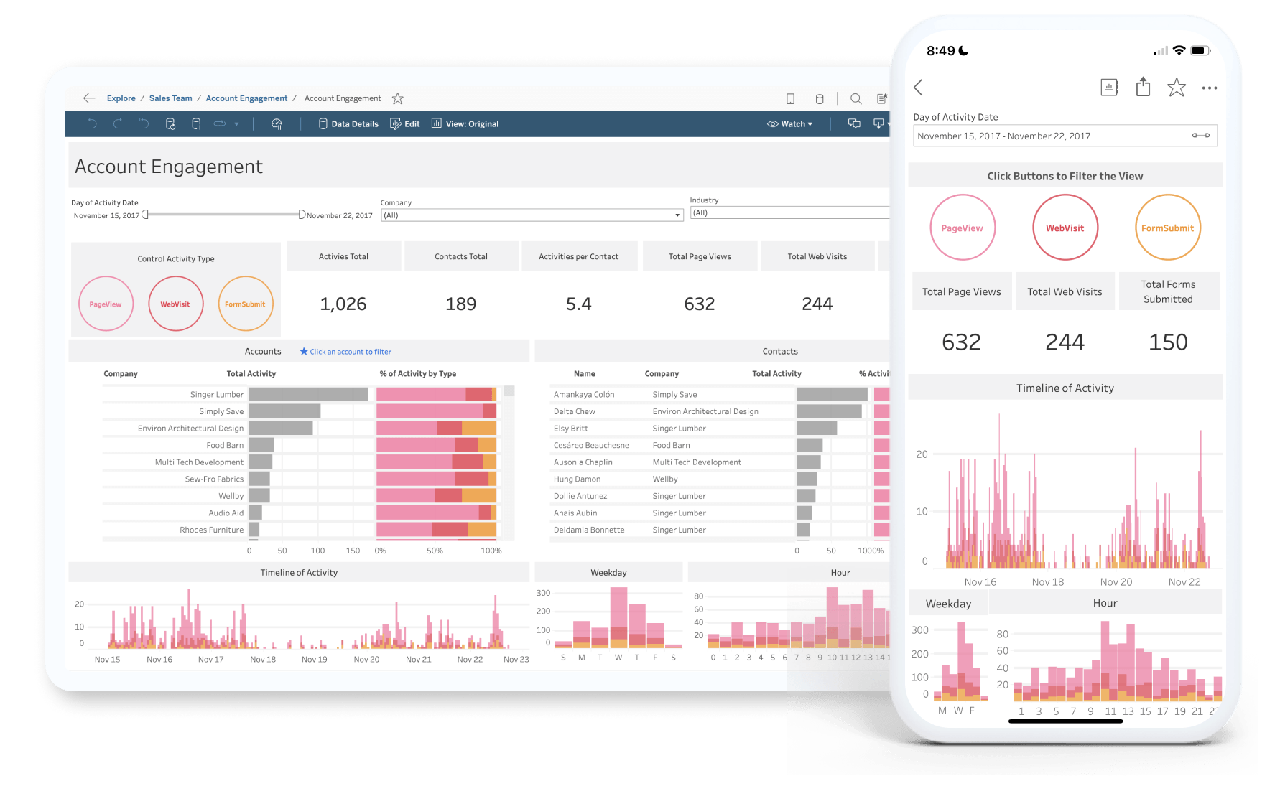

Slide 9
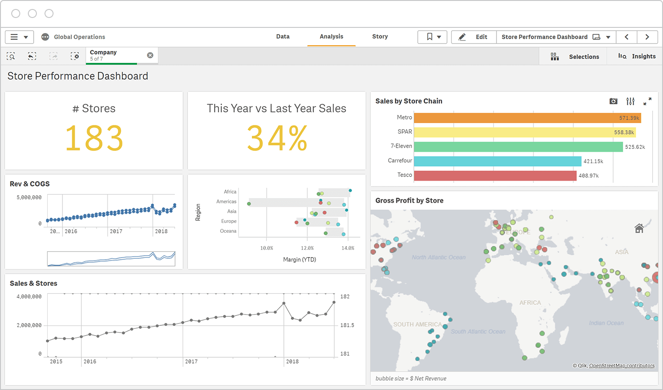

Slide 10
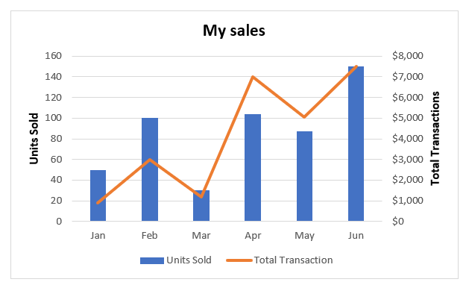
Comparison: How Do Our Sales Stack Up?
A retailer wants to compare total monthly sales across product categories and regions to identify performance gaps.
Chart Types: Bar, Column, Bullet, Clustered Column

Slide 11
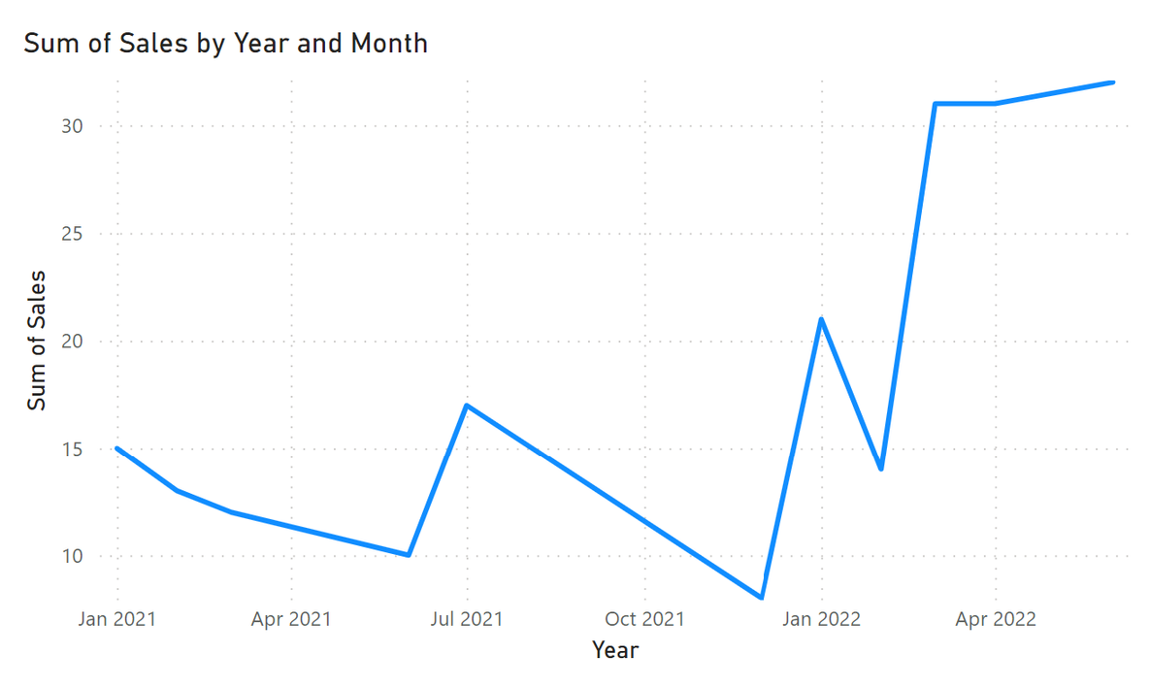
Trend Over Time: How Are We Performing Month-to-Month?
A manufacturing business tracks monthly revenue and cost to understand seasonality and profitability.
Chart Types: Line, Area, Combo (Line + Column)

Slide 12
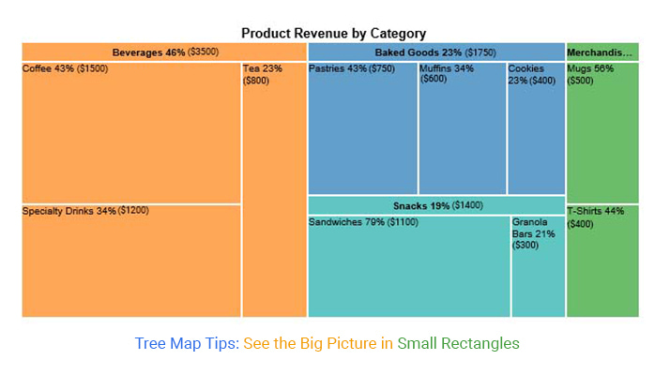
Part-to-Whole: What Portion Does Each Segment Represent?
An e-commerce company wants to understand how different product categories contribute to total revenue.
Chart Types: Pie, Donut, TreeMap

Slide 13
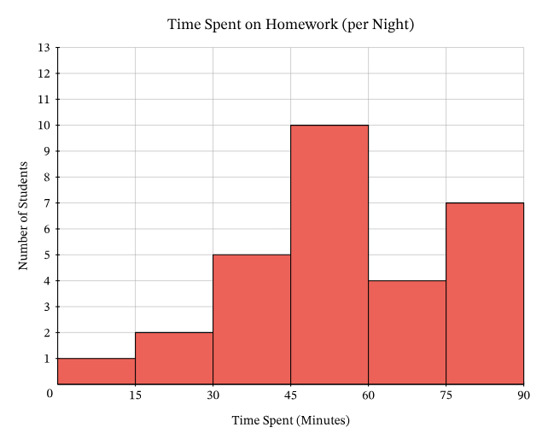
Distribution: How Is Our Data Spread?
A logistics company wants to understand delivery times across all orders to assess reliability.
Chart Types: Histogram, Box Plot, Column Distribution

Slide 14
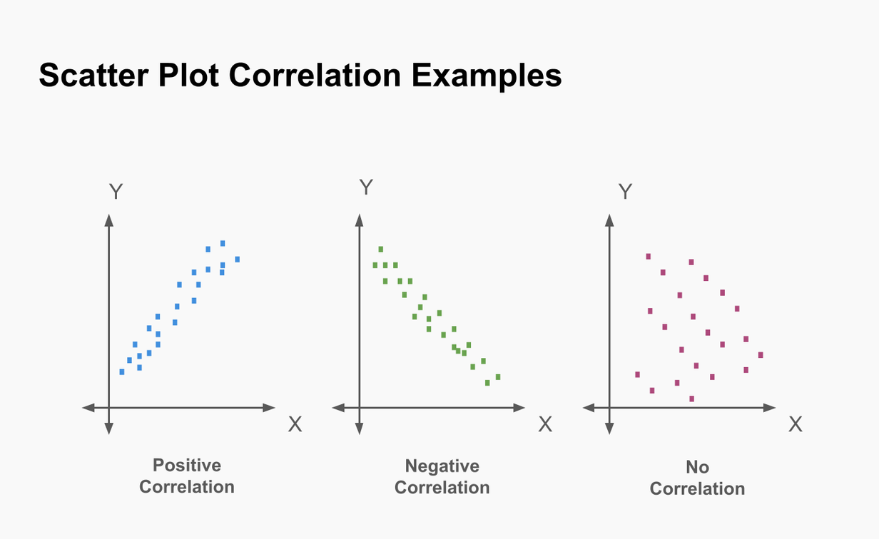
Relationship: Are Two Factors Linked?
A marketing manager wants to see whether higher ad spend leads to more sales conversions across campaigns.
Chart Types: Scatter Plot, Bubble Chart

Slide 15
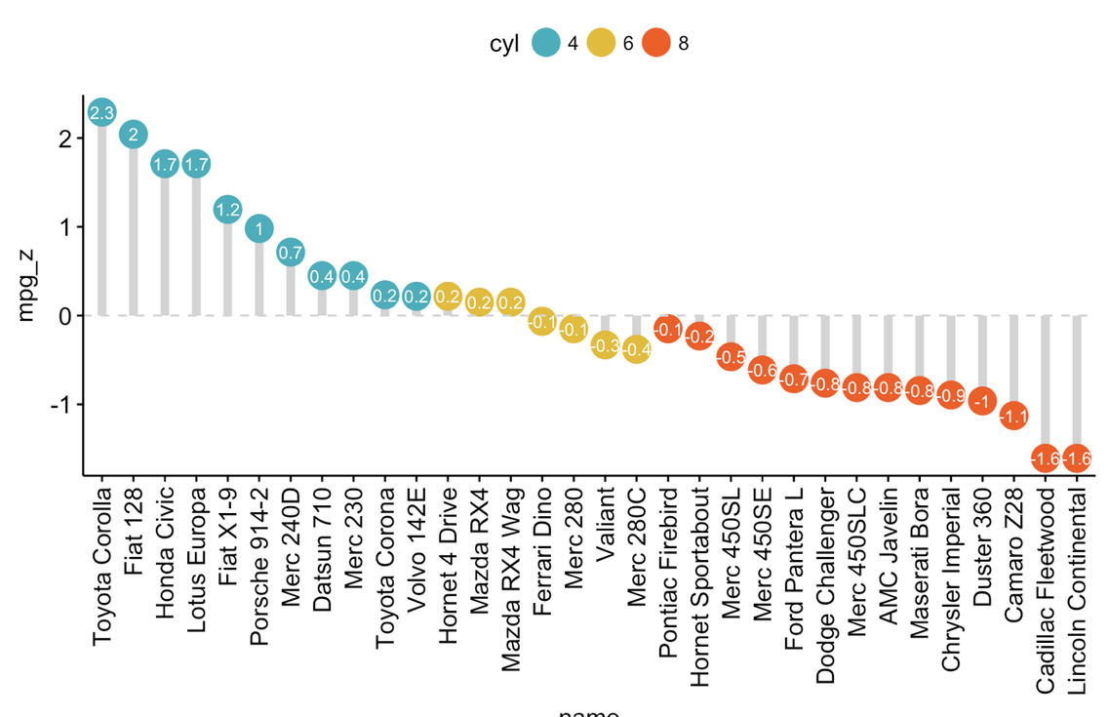
Ranking: Who Are Our Top Performers?
A sales director wants to see which customers or sales reps are generating the most revenue.
Chart Types: Sorted Bar/Column, Lollipop Chart

Slide 16
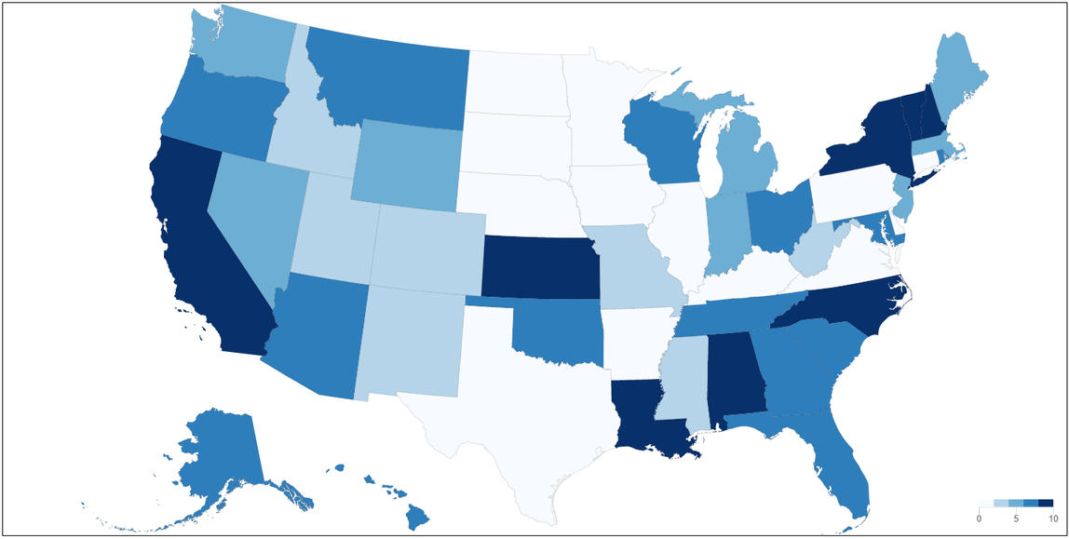
Geographic: Where Are We Performing Best?
A retail chain wants to visualise sales by region, pinpointing strong and weak areas.
Chart Types: Map, Filled Map, Heat Map

Slide 17
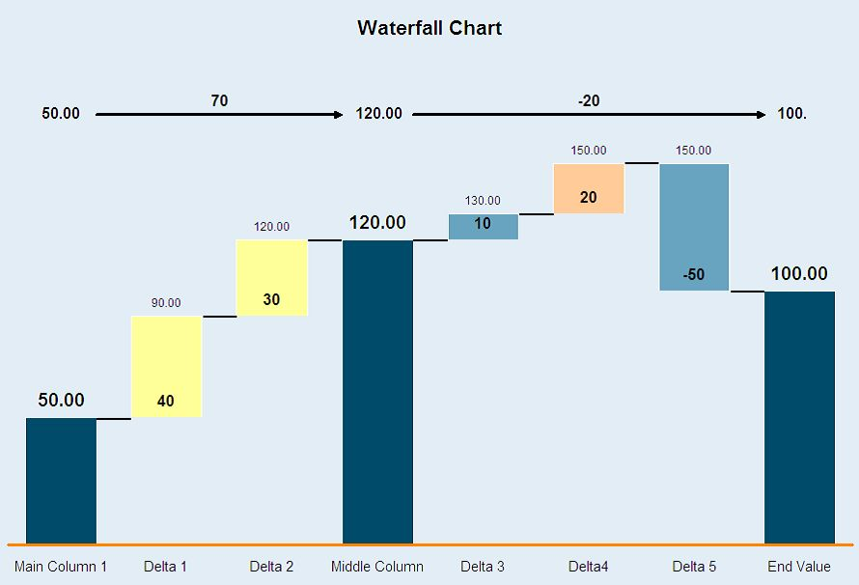
Advanced: How Did We Get From A to B?
A finance manager wants to understand how profit changed from last quarter to this one, step by step.
Chart Types: Waterfall, Gauge, Funnel

Slide 18

Some Tips
Don’t use too much colour.
Make use of filters.
Use tables and pivot tables where appropriate.
Don’t use 3D visuals.
Limit charts per screen, one screen should typically address one key question.
Notes:
ChatGPT probably created the largets spike in AI interest for the past few years. Before that we had jeopardy champions and AlphaGo. The interest has been mounting since the age of Big Data in the early 00's and has led to development of algorithms and tech capabilities.

Slide 19
PowerBI Live Demo

Slide 20
Thank You
Any Questions?

