Slide 1


Data Analytics Webinar: Data Storage

Slide 2














MANAGING THE DATA LIFECYCLE
Clean
Analyse
Generate & Capture
Store
Present & Consume
Notes:
Where are we currently with AI? And why am I asking you to forget about it?

Slide 3

Why Storage Matters
  Most companies still rely on Excel files, shared drives or on-prem databases.
  These limit scalability, reliability, security and analytics potential.
  Cloud storage offers elasticity, governance, and integration.
Notes:
ChatGPT probably created the largets spike in AI interest for the past few years. Before that we had jeopardy champions and AlphaGo. The interest has been mounting since the age of Big Data in the early 00's and has led to development of algorithms and tech capabilities.

Slide 4
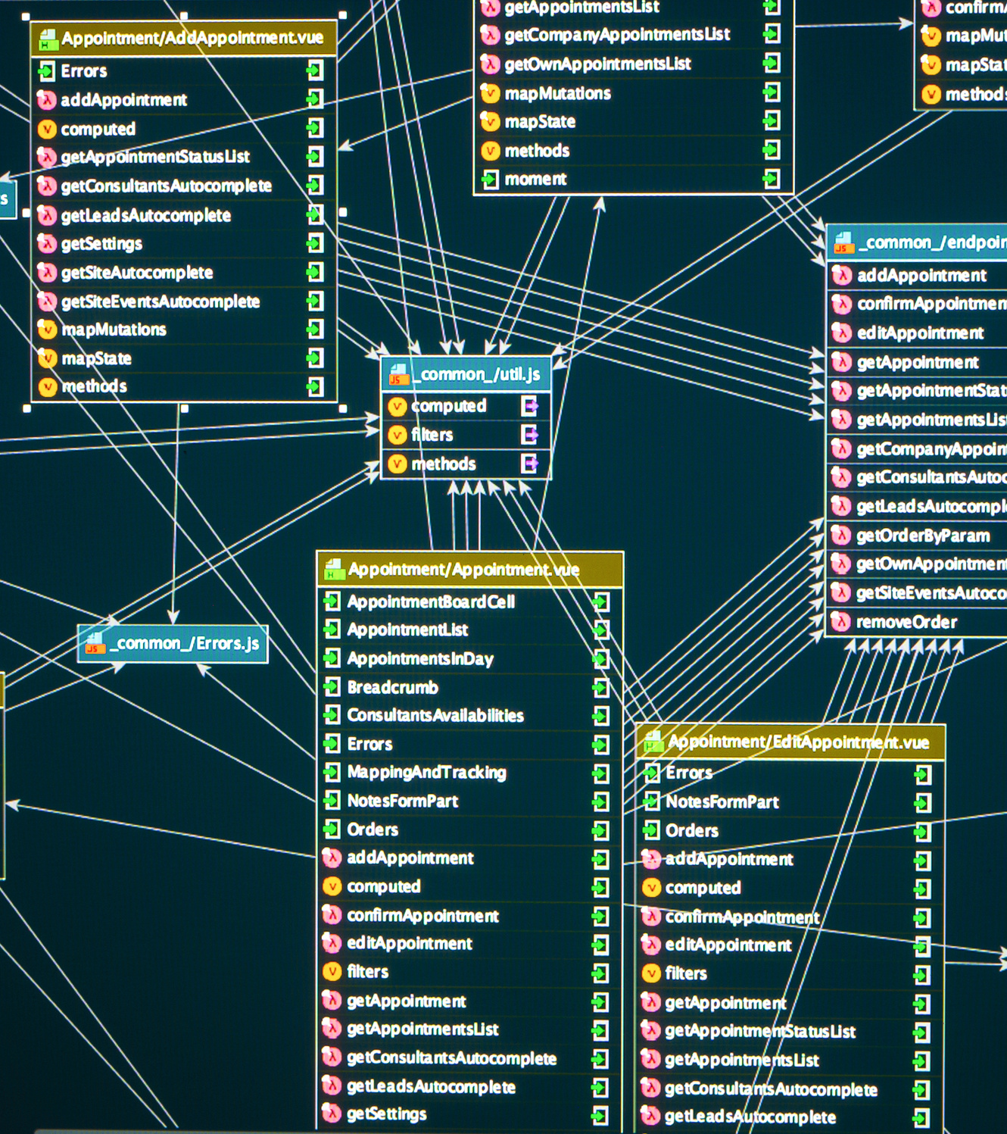
Relational Databases (SQL)
  Think of this like a set of tidy spreadsheets that are linked together.
  Each table has rows and columns, for example, one table for customers and another for orders
  Best for well-structured data that doesn’t change shape
Notes:
ChatGPT probably created the largets spike in AI interest for the past few years. Before that we had jeopardy champions and AlphaGo. The interest has been mounting since the age of Big Data in the early 00's and has led to development of algorithms and tech capabilities.

Slide 5
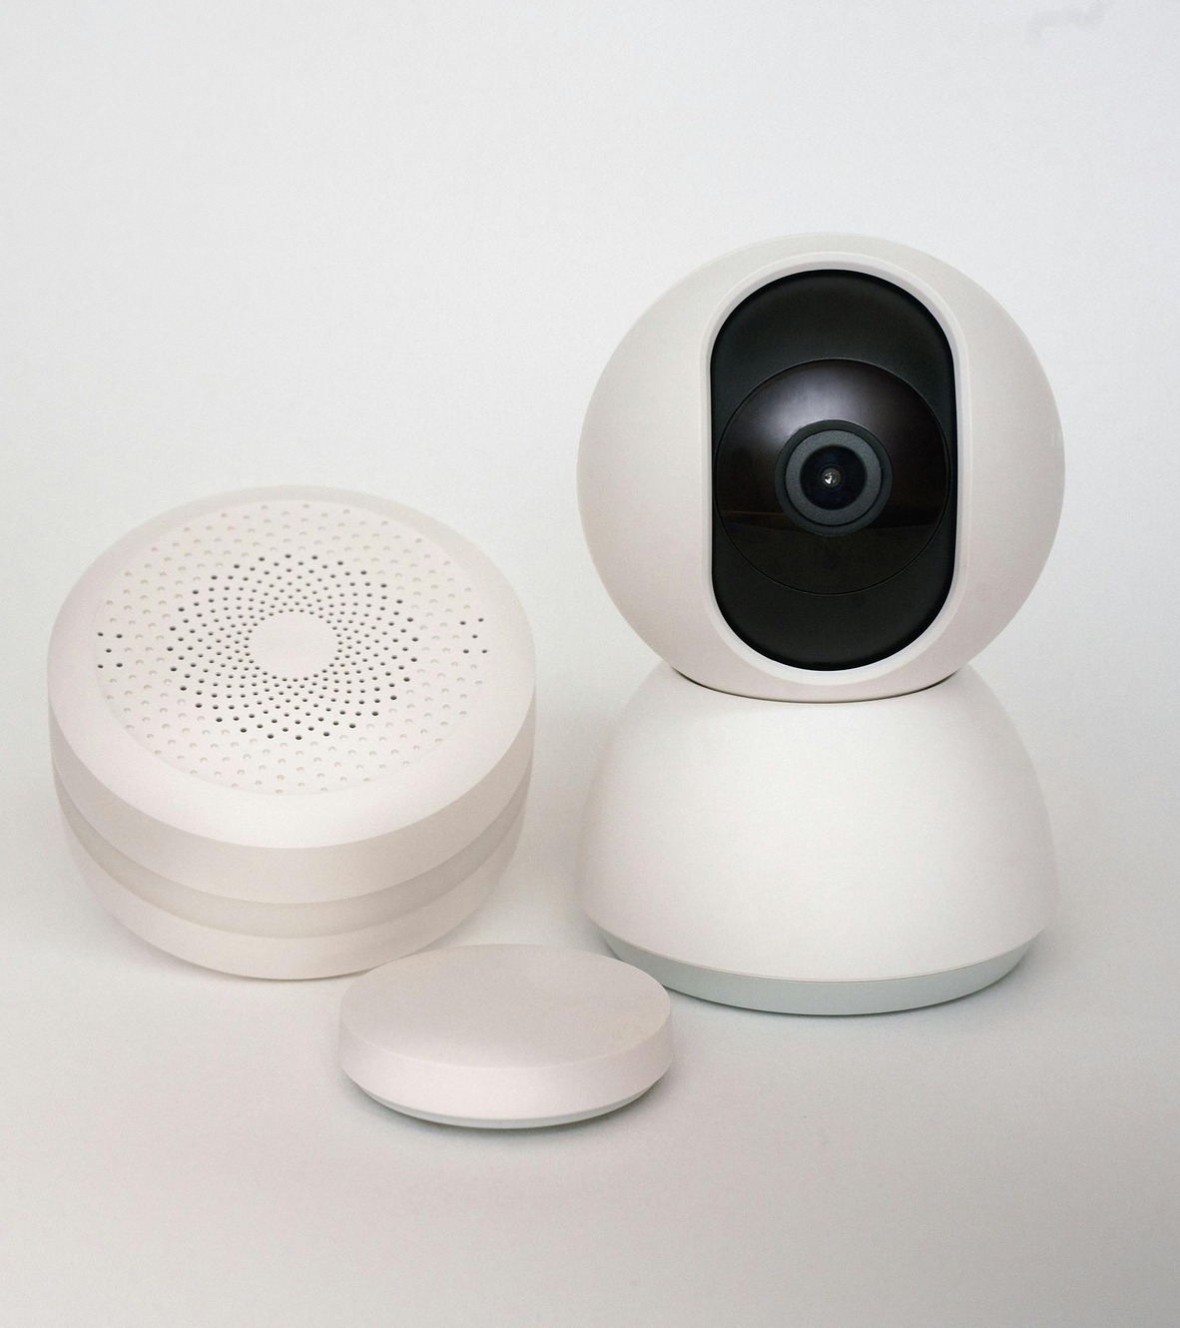
Non-Relational Databases (NoSQL)
  These are more flexible than the spreadsheet-style databases above.
  Best for data that doesn’t fit neatly into tables, app usage data or IoT sensors.
Notes:
ChatGPT probably created the largets spike in AI interest for the past few years. Before that we had jeopardy champions and AlphaGo. The interest has been mounting since the age of Big Data in the early 00's and has led to development of algorithms and tech capabilities.

Slide 6

Blob Storage
  Think of this as a massive digital filing cabinet where you can store any type of file, documents, images, videos, backups or raw data exports.
  Each file is stored as an individual “object,” ready to be retrieved whenever needed.
  Best for large files or data that doesn’t need to live in a database, media, backups or raw analytics data.
Notes:
ChatGPT probably created the largets spike in AI interest for the past few years. Before that we had jeopardy champions and AlphaGo. The interest has been mounting since the age of Big Data in the early 00's and has led to development of algorithms and tech capabilities.

Slide 7

Vector Stores
  This is the newest and most exciting type of storage, used mainly for AI applications.
  Vector stores hold numerical representations of text, images, or audio (called embeddings) that help AI systems understand meaning, not just exact words.
  Best for AI-driven tools like chatbots, intelligent search, and recommendation systems.
Notes:
ChatGPT probably created the largets spike in AI interest for the past few years. Before that we had jeopardy champions and AlphaGo. The interest has been mounting since the age of Big Data in the early 00's and has led to development of algorithms and tech capabilities.

Slide 8



Microsoft Azure
The Big 3
Google Cloud Platform
Amazon Web Services
Notes:
ChatGPT probably created the largets spike in AI interest for the past few years. Before that we had jeopardy champions and AlphaGo. The interest has been mounting since the age of Big Data in the early 00's and has led to development of algorithms and tech capabilities.

Slide 9


Slide 10
SQL Live Demo

Slide 11
Thank You
Any Questions?

